Slide 1


Toxicity Datasheets and Microsheets

Slide 2
UK Water Industry Research Limited
Established in 1993 to undertake single voice research on behalf of the UK water industry
Shapes and leads the future research agenda for the industry by identifying and responding to current and future challenges
Membership comprises UK water companies who participate in project steering groups to guide the work undertaken
Undertakes high value independent collaborative research both nationally and internationally
Research undertaken provides robust and reliable evidence on behalf of the membership, enables informed interaction with regulators and delivers financial savings
Encourages sharing of best practice and continuous improvement
Notes:
Contractors should be encouraged to present the outputs of UKWIR projects to external audiences, for example at conferences and seminars.
When they do so, UKWIR’s role in the work they describe must be acknowledged.
The information on this slide is provided to assist the presenter to give a brief description of UKWIR and may be used selectively, as is appropriate to the event.

Slide 3
Toxicity Datasheet and Microsheets
What are they?
  Two separate databases developed over 25 years with significant funding and support from the UK Water Companies
  Specific to the needs of the water and waste water community for assistance in dealing with chemical and microbiological contaminants in water
  Authoritative source of information for discussions with regulators and health agencies
  Continuously updated to incorporate the latest information

Slide 4
Toxicity Datasheet and Microsheets
How are they used?
  Rapid response to contaminants in water
    Will contaminant be removed by Water Treatment plant?
    What are the heath implications?
    Can the water still be used (drunk)?
    What are the environmental consequences?
  Quantifying the unknown chemical contaminant
    Analytical methods
    Taste and odour thresholds
    Flavour and odour detection
  Authoritative source of information

Slide 5

Toxicity Datasheets

Slide 6
UKWIR Toxicity Advisory Service
This service consists of three main elements:
Toxicity Datasheets
  Preparation, review and revision
24-Hour Enquiry and Emergency Service
  Drinking water
  Wastewater
  Environmental Waters
  Human Health and Environmental assessment
Current Awareness Reports
  Scientific and Regulatory Developments
  Tailored to water industry

Slide 7
Toxicity Datasheets
Over 600 datasheets on individual and groups of chemicals
Three main types
  Full Datasheets
    Contain detailed information on occurrence and use, mammalian toxicity, ecotoxicity, fate and behaviour and removal of chemicals during drinking and wastewater treatment
  Group Datasheets
    Covers groups of chemicals or materials, e.g. polycyclic aromatic hydrocarbons (PAHs), fire fighting foams.
    Limited information on specific chemicals, but provides a summary of the group of chemicals
  Minisheets (to be upgraded to full sheets with time)
    CCL3 Chemicals
    EU Approved pesticides
Datasheets undergo five levels of update and peer-review and the process has ISO9001 quality control accreditation

Slide 8
Content and Availability
Available to WaterISAC subscribers over the Internet.
Content is regularly reviewed and updated
  100 Toxicity Datasheets are updated per year
  Minimum of a five year update cycle
  Date of last update is recorded
Five new Toxicity Datasheets produced per year
  Suggestions for new Toxicity Datasheets welcomed from all users
  Substances selected by UKWIR Steering Group consisting of water industry professionals and an independent expert in chemical toxicity in water

Slide 9
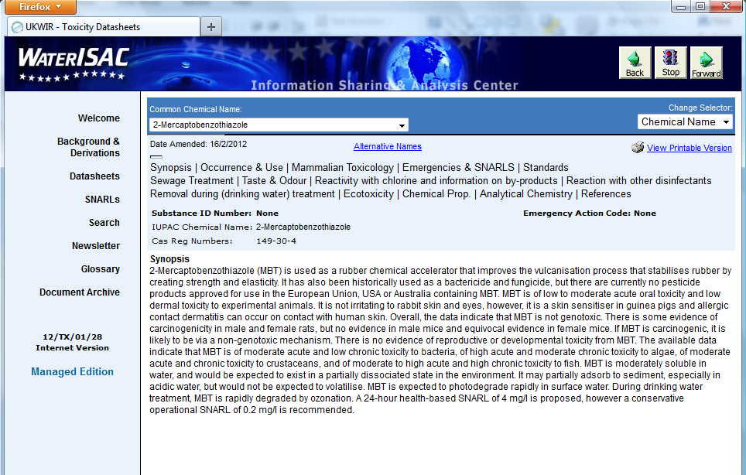
WaterISAC View of Toxicity Datasheets

Slide 10
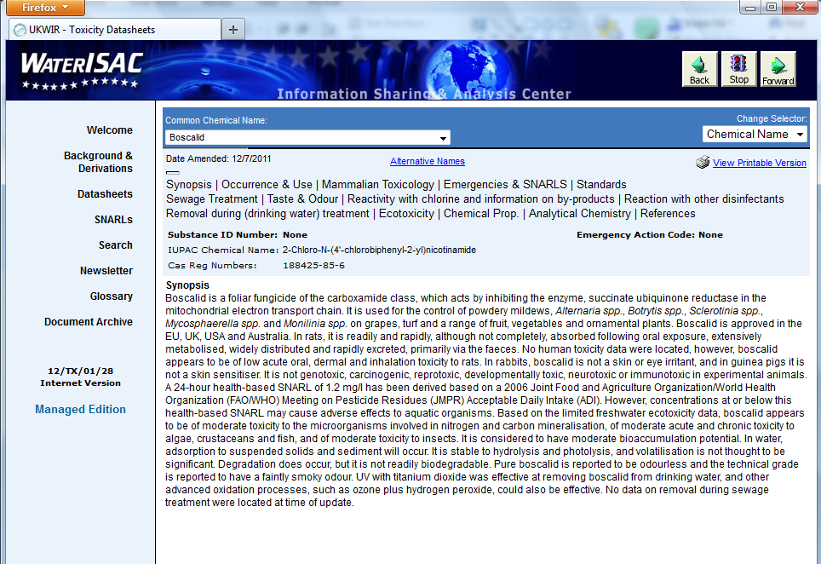
Content

Slide 11
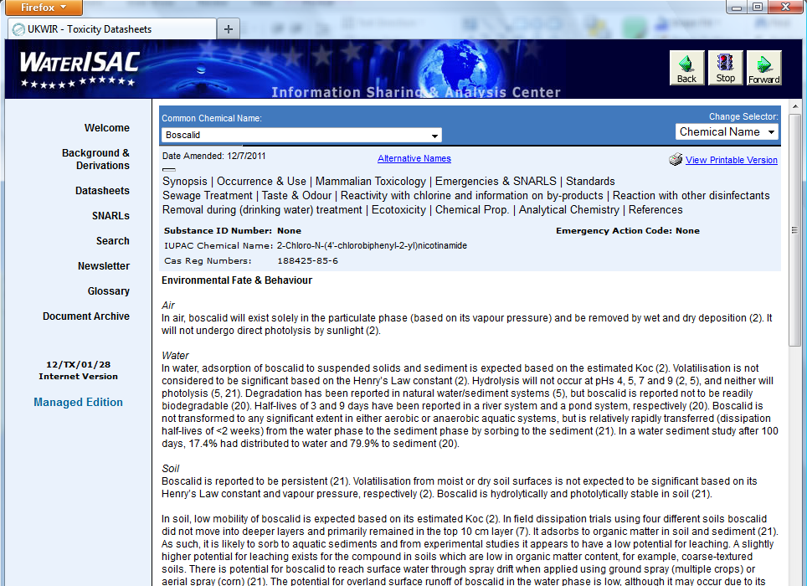
Content

Slide 12
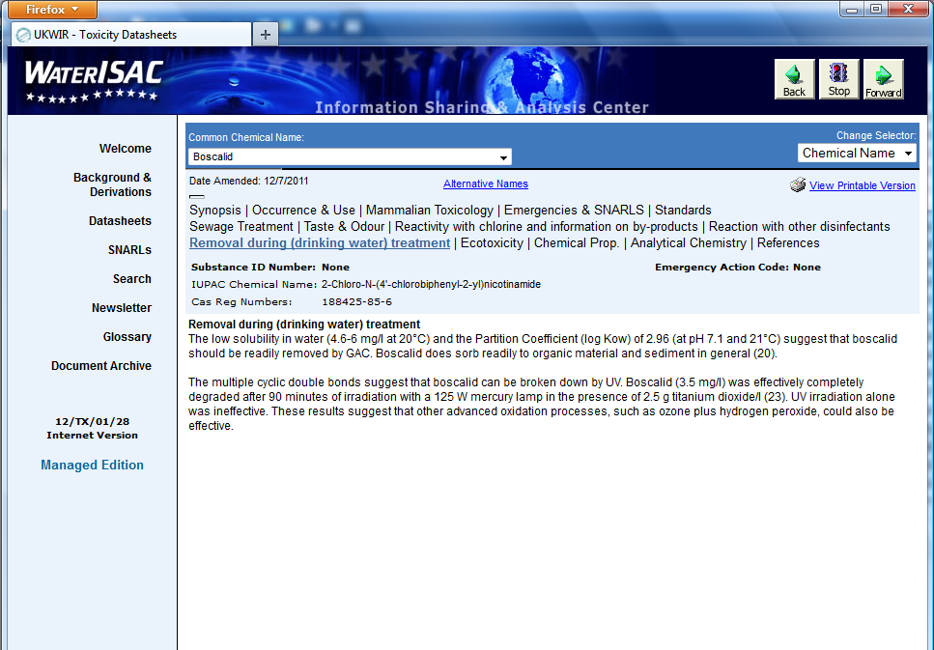
Content

Slide 13
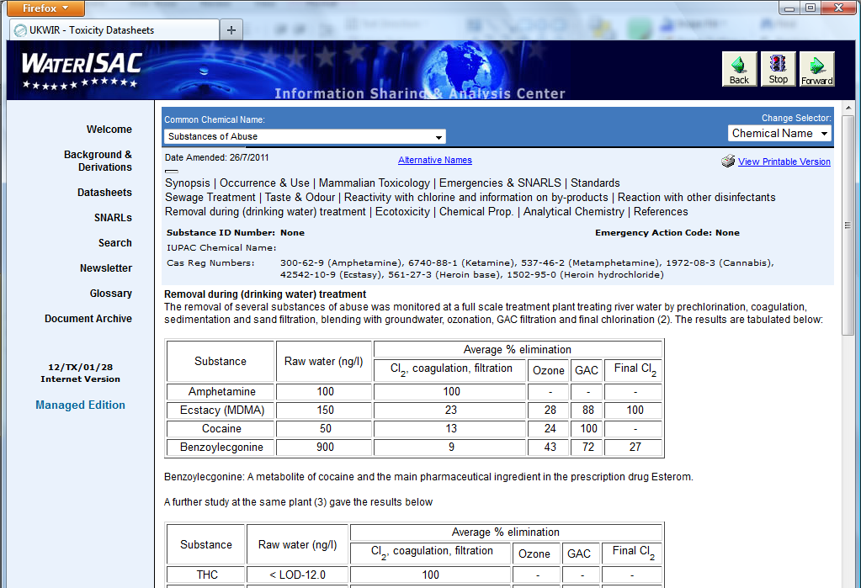
Content

Slide 14
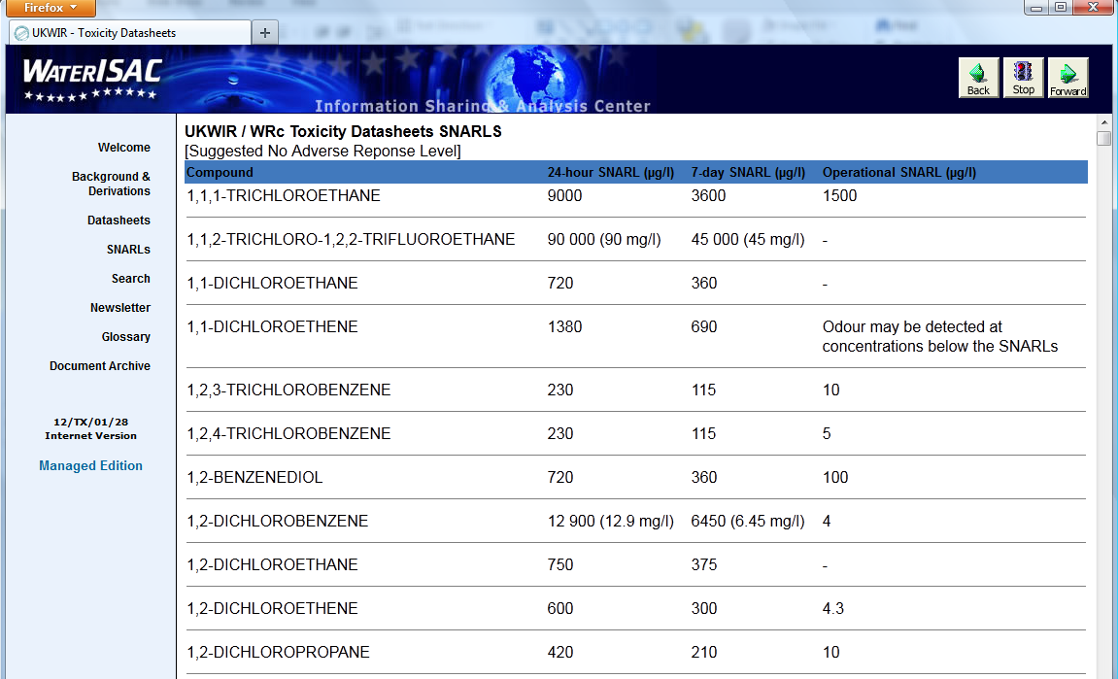
Content

Slide 15
Relevance to the US Water Industry
Contains US-specific pesticide, medicine and water treatment chemical approval data
International data on occurrence of chemicals
Includes information from a number of Regulators and sources based in the USA, including:
  Environmental Protection Agency
  National Toxicology Program
  Food and Drug Administration

Slide 16
SNARLs
What is a SNARL?
  Suggested No Adverse Response Level
  Health-based SNARLs
  Operational SNARLs
Under the Emergencies and SNARLs section of Toxicity Datasheets
Health-based SNARLs are specifically derived for human exposure via drinking water in emergency situations, i.e. short-term exposure.
  This is unique to Datasheets and makes them invaluable for pollution incident management
Operational SNARLs are based on taste/odour thresholds

Slide 17
Derivation of Health-based SNARLs
Establish Acceptable or Tolerable Daily Intake (ADI/TDI)
  Concentration considered ‘safe’ in mg/kg bodyweight/day
Check for existing values using hierarchy of sources
  Toxicological basis and relevance
  Year of derivation
Typically assume a 60 kg adult drinks 2 litres of water per day
Conservative enough to cover inhalation and dermal exposure
Health-based SNARLs are designed to give a safe value to compare with levels in both raw water and supply
  but they often change over time, and as the datasheets are updated.

Slide 18
Hierarchy of Information
International Committees
  WHO Drinking Water Guidelines
  WHO/FAO Joint Meeting on Pesticide Residues (JMPR)
  WHO/FAO Joint Expert Committee on Food Additives (JECFA)
  WHO IPCS Environmental Health Criteria
  International Agency for Research on Cancer (IARC) Monographs
  European Food Safety Authority (EFSA)
National Authoritative Bodies
  UK Health Protection Agency
  UK Food Standards Agency
  US Environmental Protection Agency
  US National Toxicology Program
Sources of Information from Non-Authoritative Organisations

Slide 19
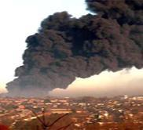

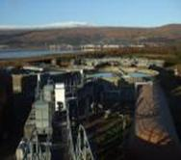
How Toxicity Datasheets are Used:
Major events and problems
Buncefield oil depot explosion 2005, biggest explosion in Europe since WWII - fire water chemicals and PFOS in fire fighting foam
High levels of aluminium in Scotland 2011
Widespread contamination with slug pellets containing metaldehyde (European pesticide standard 0.1 μg/l)
“Smelly water” (BBC) - taste and odour in drinking water contaminated with 2-EDD and 2-EMD, UK 2010

Slide 20
Case Study One: Taste and Odour incident 2010
Complaints of taste and odour in drinking water in area of 2 million people
Water Company consulted Toxicity Datasheets and had a potential identification from taste and odour descriptors in Flavour wheel and history
Contaminant confirmed as 2-ethyl-5,5-dimethyl-1,3-dioxane (2-EDD) and 2-ethyl-4-methyl-1,3-dioxolane (2-EMD) which have very low taste and odour thresholds (5-10 ng/l)
The maximum concentrations detected were 2-EDD 0.026 μg/l and
2-EMD 0.186 μg/l
The only collation of data available for 2-EDD and 2-EMD was in the Toxicity Datasheets
Toxicity data limited to LD50s 2-EDD 24-hour SNARL of 2.5 mg/l
2-EMD 24-hour SNARL of 1.4 mg/l
SNARLs used by Health Protection Agency as Action Levels and therefore no risk to human health
History of other events worldwide including the first in River Wem in England in 1994, Philadelphia and Barcelona

Slide 21
Case Study Two: Hydrocarbon contamination
Most common occurring of water quality problems
Fuel spills penetrating plastic pipes, e.g. leaky cars on forecourts
Degradation of coal tar pitch linings in old pipe systems especially when flushing through after maintenance
Domestic (mis)use with ‘solvent taste’ following use of paint remover, lubricants, glue, etc.
Toxicity datasheets are available for:
  Some products: Kerosine, Petrol, Petrol additives, Coal tar creosote, Diesel fuel, White spirits (Stoddard solvent, mineral spirits)
  Individual components

Slide 22
Key issues with individual components
BTEX: benzene, toluene, ethylbenzene, xylenes
Polycyclic aromatic hydrocarbons (PAHs) and individual chemicals, benzo[a]pyrene, anthracene, fluoranthene, naphthalene
  Toxicity of PAHs varies widely and depends on structure
  Solubility of PAHs can indicate their likely source
Hydrocarbons analysis often grouped based on number of carbons and structure e.g. C5-C8, C9-C16, C17-C35, aliphatic and aromatic
  Toxicity and SNARLs based on use of surrogate chemicals for these groups (work of the US TPHCWG)

Slide 23

Microsheets

Slide 24
Focus
The primary focus is on drinking water rather than wastewater
Includes all aspects of water supply from source to tap
Reliable source of information for water companies
Greater emphasis being placed on quantitative data to support water company risk assessments
WRc responsible for managing database and producing all documents with support from the UK Health Protection Agency
Directed by a steering group drawn from across UK water companies and drinking water quality regulator.

Slide 25
Database Content – 3 Main categories of Factsheets
Detailed single-organism factsheets on all acknowledged waterborne pathogens and recognised nuisance organisms
Occasional generic factsheets covering a specific issue
Factsheets on selected pathogens of concern to animal health

Slide 26
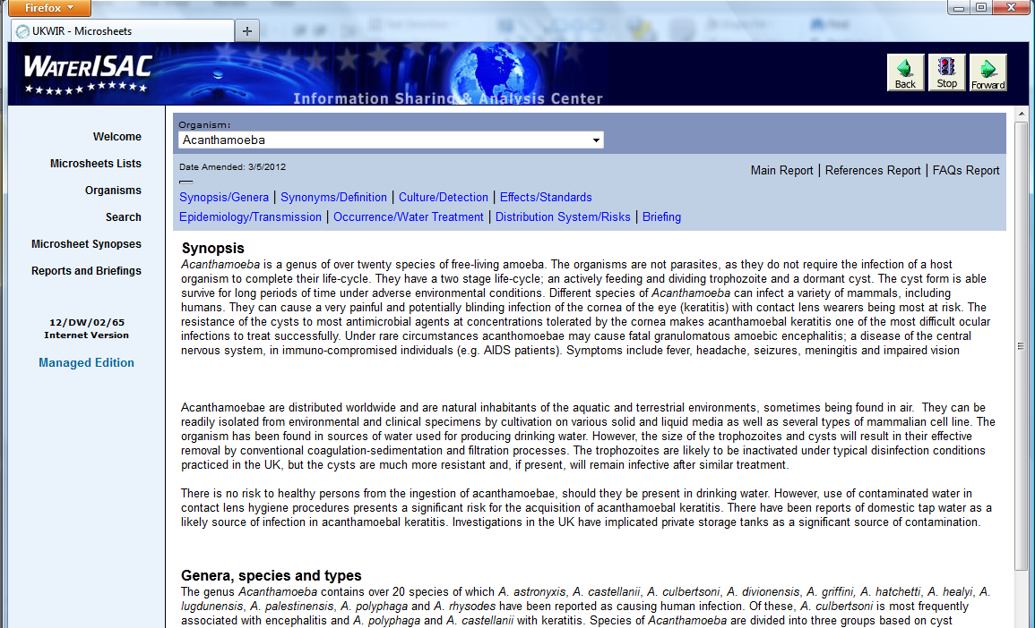
Content

Slide 27
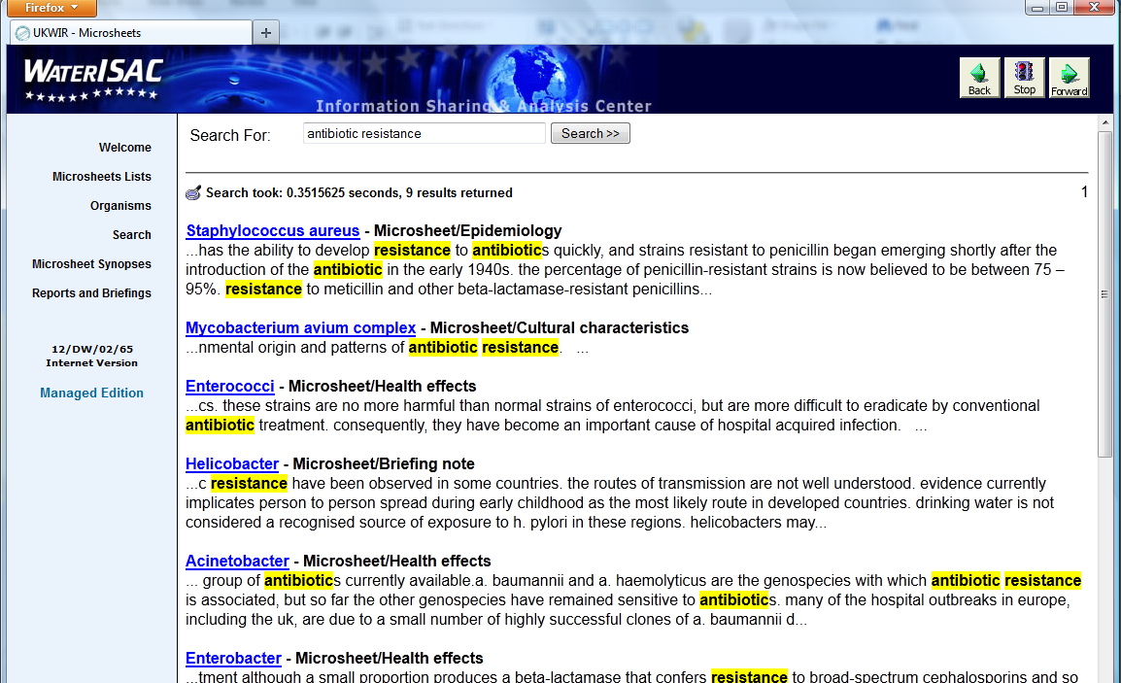
Content

Slide 28
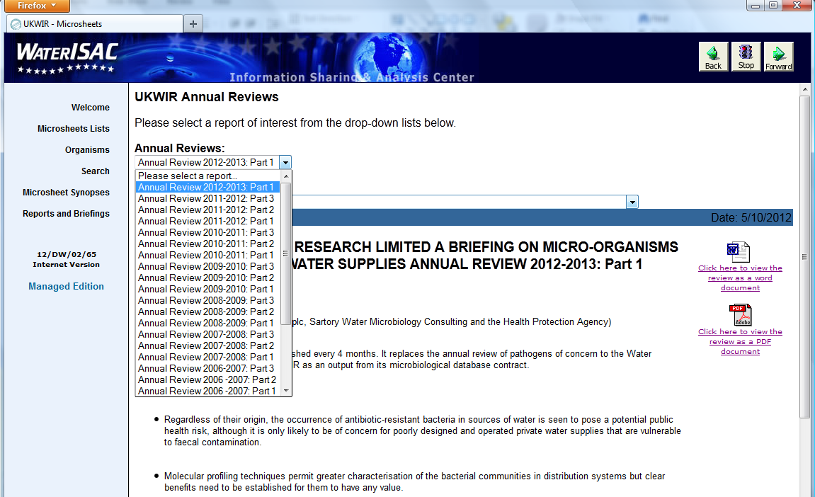
Content

Slide 29
Database Content – Other sources of information
Periodic topic reviews of current literature
Yearly special topic reviews of developments deemed to be of particular significance
Briefing notes on suddenly emergent issues
Other organism section to cover pathogens not been associated with drinking water or those that may be found but are of no public health significance.

Slide 30
Specific Feature - Frequently Asked Questions
Each main factsheet provides answers to “typical” media, public enquiries, such as:
What is it?
Where does it come from?
Does it pose a risk to drinking water consumers?
What is being done?
Can my pets drink the water?

Slide 31
Toxicity Datasheets and Microsheets
Unique source of information on chemicals and micro-organisms relevant to the Water Industry
Available to all WaterISAC subscribers
Visit and try it out
Hopefully it will become valuable to your work (if not already!)
All comments and suggestions to……..

Slide 32


Thank you
Dr Paul Rumsby paul.rumsby@wrcplc.co.uk
Dr David Holt dholt@ukwir.org
WRc plc UKWIR
Frankland Road 1 Queen Anne’s Gate
Swindon London SW1H 9BT
Wiltshire SN5 8YF
UK
Tel: 44 1793 865000 44 2073 441806
www.wrcplc.co.uk www.ukwir.org

