Slide 1



U.S EPA’s Tabletop Exercise Tool for Water Systems: Emergency Preparedness, Response, and Climate Resiliency – Training Webinar
May 26, 2011, 3:00 – 4:00 pm EDT
Notes:
1

Slide 2
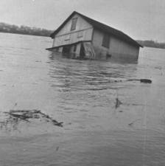
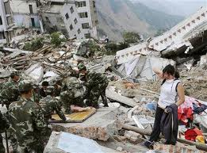
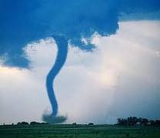
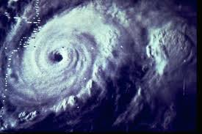
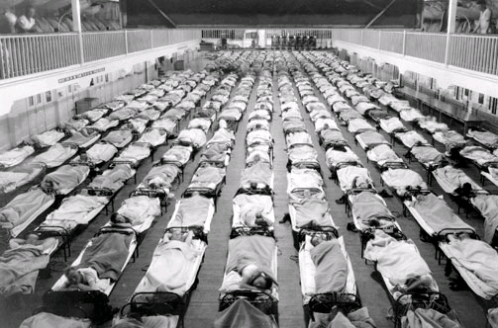
EPA’s Tabletop Exercise Tool for Water Systems: Emergency Preparedness, Response, and Climate Resiliency Webinar
May 26, 2011

Slide 3
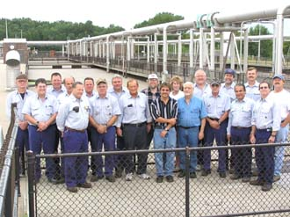
Participant Introductions
Notes:
Additional Information for the user

Slide 4

Webinar Objectives
Demonstrate EPA’s Tabletop Exercise Tool and how it is useful in creating exercises
Show participants how to get the Tool
Notes:
Objectives of this training are to familiarize you with the materials on the updated Tabletop Exercise Tool, and better inform of how these materials can be used to customize, plan, facilitate, and evaluate a TTX.

Slide 5
Introduction to Tabletop Exercises

Slide 6
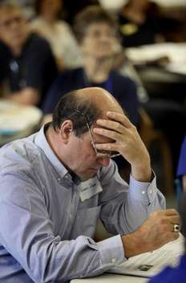
What is an exercise?
Something performed or practiced in order to develop, improve, or display a specific power or skill.
To practice in order to
train, strengthen, or
develop.
Notes:
This is the dictionary definition.
Different people define "exercise" in different ways
training and drills (i.e. a noun)
a way to evaluate and confirm the soundness of policies and procedures, through in-depth discussion (i.e. a verb)
An exercise can be all of these-and more.
Take many forms depending on scope and objective of the exercise
Exercises range in cost, scope, complexity, purpose and approach

Slide 7
Why do we exercise?
Evaluate operations and plans
Improve readiness
Clarify roles and responsibilities
Improve performance and coordination
Uncover resource gaps
Identify opportunities for improvement
Notes:
Exercises provide a safe environment to:
Evaluate operations and plans
Improve readiness
Clarify roles and responsibilities
Improve performance and coordination
Uncover resource gaps
Identify opportunities for improvement

Slide 8

Discussion-Based Exercises
Familiarize participants with current plans, policies, agreements and procedures
May be used to develop new plans, policies, agreements, and procedures.
Notes:
Discussion-Based Exercises center on participant discussion
Provide a forum for discussing or developing plans, agreements, training, and procedures
Less complicated and costly than operations-based exercises
Focus on strategic, policy-oriented issues
Include seminars, workshops, tabletops and games
Do not involve deployment of resources
Are led by a facilitator who helps keep participants on track and ensures that exercise objectives are met

Slide 9
Tabletop Exercise
Involves staff, elected or appointed officials, and other key personnel
Is based on a hypothetical scenario
Is informal and the “no fault” rule applies
Tests plans and procedures inexpensively
Has no time pressure
Identifies strengths and weaknesses, as well as planning gaps
Notes:
Additional Information for the user

Slide 10
Poll Question
Who would you invite to your tabletop exercise?
Local emergency management agency or manager
State emergency management agency
Police
Fire
State primacy agency (water and wastewater)
Public health
Emergency medical services
911 dispatch center personnel
Environmental agencies
Critical customers (e.g., hospitals, schools)
Agriculture agencies
Elected officials
Notes:
Exercises provide a safe environment to:
Evaluate operations and plans
Improve readiness
Clarify roles and responsibilities
Improve performance and coordination
Uncover resource gaps
Identify opportunities for improvement

Slide 11
How to Use EPA’s Tabletop Exercise Tool
Notes:
The TTX Tool is easy to use and consistent with HSEEP
Designed for both novice and experienced TTX planners
(Additional resources would be needed for more complex, operations-based exercises)
Allows planners to develop and design a TTX specific to their organization
Ensures that materials are consistent with HSEEP methodology
Allows organizations to align their exercises with what is becoming the nationally accepted standard for exercise terminology and methodology
History of the TTX Tool
-This tool is an update to the 2005 version. The earlier version was focused more on terrorism and intentional events, and the updated version takes an all-hazards approach with its 15 new scenarios, 10 disaster and 5 climate change. Both the current and 2005 versions are available on the EPA’s Water Security website.
-Now let’s go through a quick demo of the TTX Tool.

Slide 12
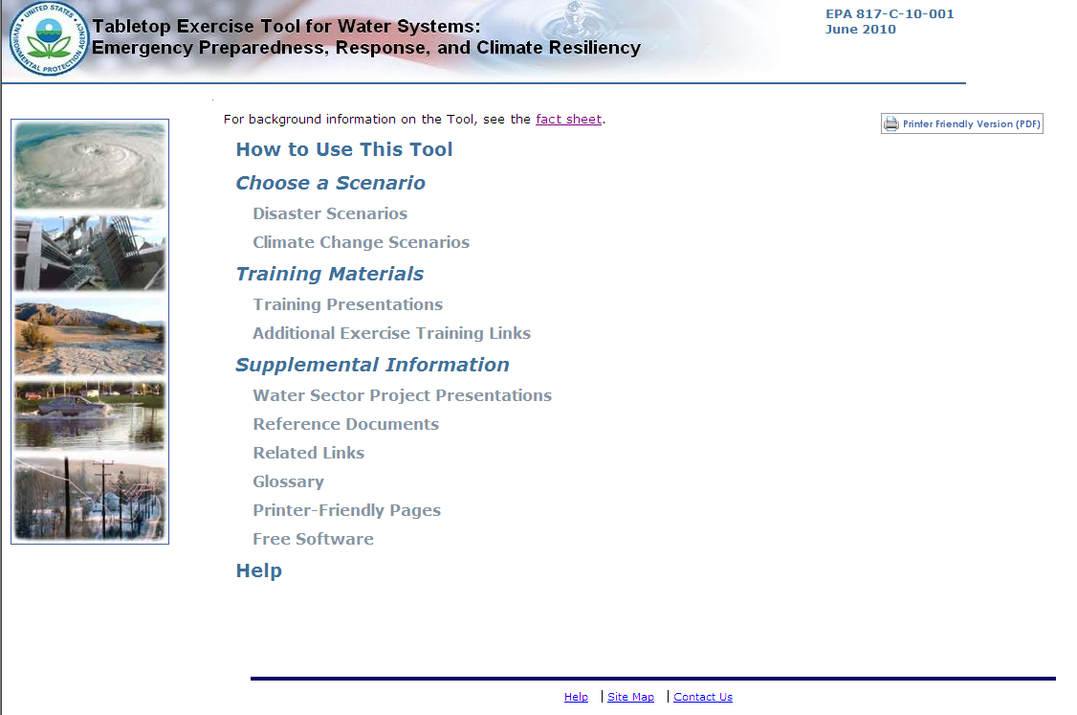
Tabletop Exercise Tool for Water Systems:
Functionality
Instructions on how to get started
Choose from 15 different exercise scenarios.
Each with a customizable:
-Situation Manual
-Presentation
-Additional Discussion Questions
Presentations on how to :
-Use the TTX Tool
-Plan, customize, conduct,
and evaluate an exercise
Water Sector-related presentations,
documents, and web links aid the
exercise planner in building a more
comprehensive TTX
-Links to training presentations and reference materials
-Contact E-mail address
Notes:
Now I would like to walk through some of the functionality of the TTX Tool. This is the home page of the TTX Tool. This page would automatically load in your internet browser after inserting the TTX Tool into your CD drive.
The “How to Use This Tool” provides general background information on the TTX tool as well as instructions on how to get starting using the materials in the tool. The “Choose a Scenario” page allows you to choose from the 15 different scenarios. Each scenario is equipped with a customizable Situation Manual, PowerPoint presentation, and additional discussion questions.
The “Training Presentations” page links you to a number of training PowerPoint presentations on how to use the TTX Tool as well as how to plan, customize, conduct, and evaluate a TTX. These presentations are included so that any user can quickly and easily get acclimated to using the tool. The tool is designed so that anyone will be able to use the tool, whether you’ve been planning exercises for years, or you’ve never even heard of a tabletop exercise—we’ve got you covered. The tool also includes links to online Independent Study FEMA courses on exercising.
The “Supplemental Information” page contains useful documents, links, and PowerPoint presentations on other Water Sector Initiatives such as WARNs (which Steve presented on earlier), ICS and NIMS training, and the Water Laboratory Alliance. The user can draw from all of these materials in order to build a more comprehensive TTX.
Note that in the corner of this page is a button that says “Printer Friendly Version.” Clicking on this button will automatically open a printable PDF version of the page you are currently viewing. You will find one of these buttons on every page of the TTX Tool. You can access the printer-friendly versions of all pages by clicking on the “Printer Friendly Pages” link here on the main page or on the sidebar of any other page. Let’s go to that page now.

Slide 13
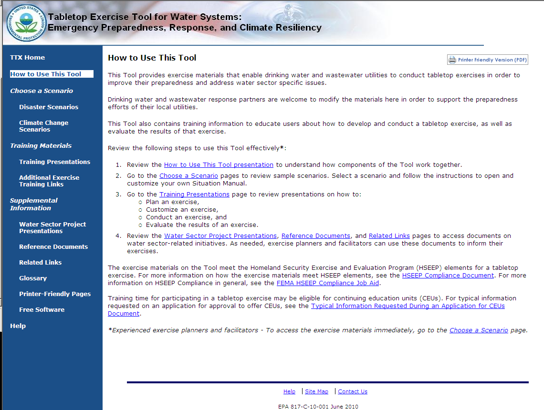
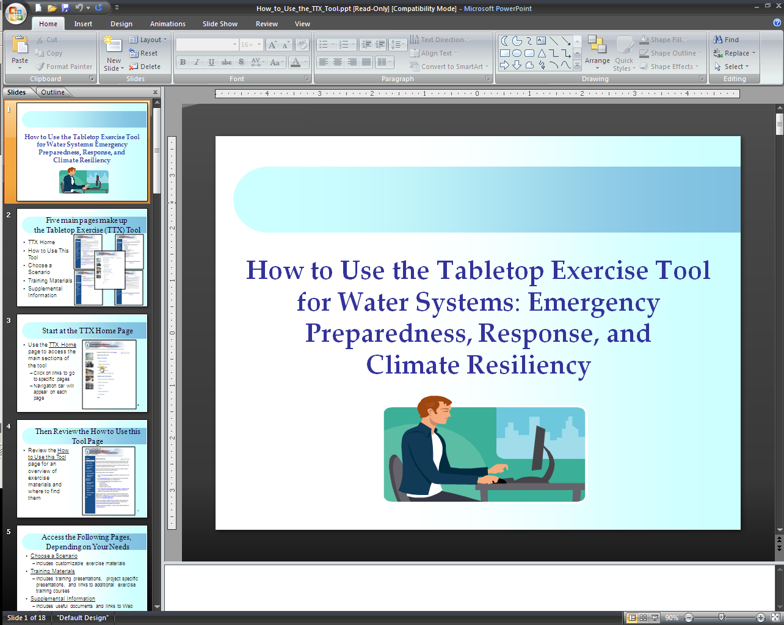
Tabletop Exercise Tool for Water Systems:
How to Use the TTX Tool
Notes:
Now let’s take a look at the “How to Use the TTX Tool” page. Here you can find links to other parts of the tool, such as the choose a scenario page and training presentations, as well as instructions on how to get started. For example, clicking on the “How to Use This Tool presentation” link, opens a PowerPoint presentation that highlights some of the functionality and available resources on the TTX Tool.
I would also like to point out this link here that provides information on the HSEEP compliance of the TTX Tool. Clicking on the circled link will load a document that lists the required elements for an HSEEP compliant TTX and highlights elements of the TTX tool that meet those requirements.

Slide 14
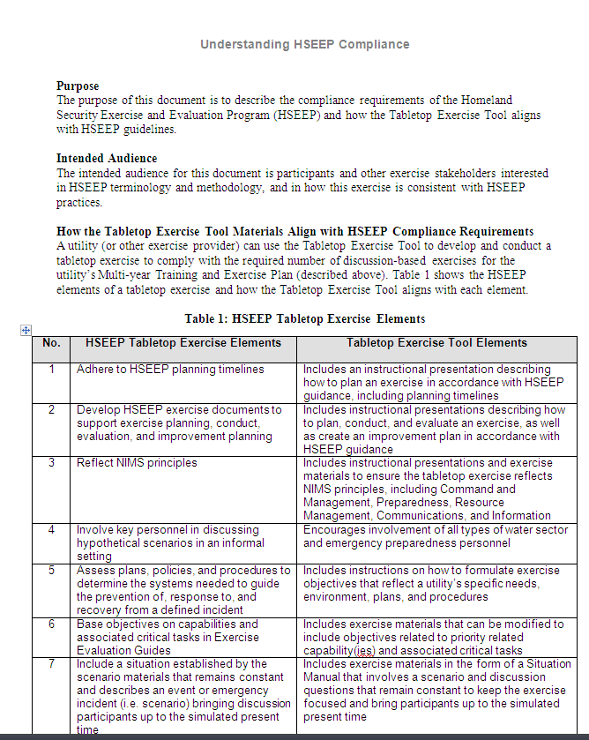
Tabletop Exercise Tool for Water Systems:
How to Use the TTX Tool
Notes:
Now let’s take a look at the “How to Use the TTX Tool” page. Here you can find links to other parts of the tool, such as the choose a scenario page and training presentations, as well as instructions on how to get started. For example, clicking on the “How to Use This Tool presentation” link, opens a PowerPoint presentation that highlights some of the functionality and available resources on the TTX Tool.
I would also like to point out this link here that provides information on the HSEEP compliance of the TTX Tool. Clicking on the circled link will load a document that lists the required elements for an HSEEP compliant TTX and highlights elements of the TTX tool that meet those requirements.

Slide 15
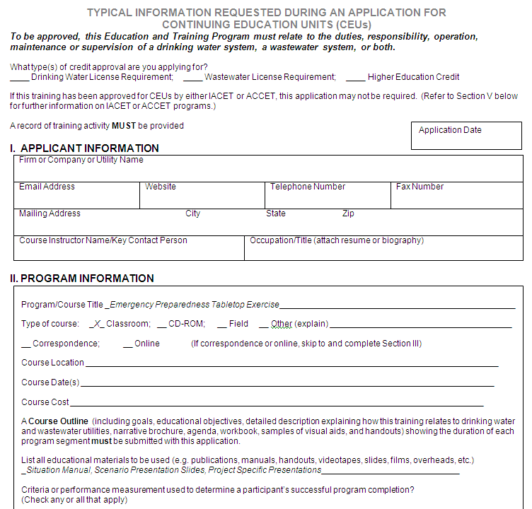
Tabletop Exercise Tool for Water Systems:
How to Use the TTX Tool
Notes:
Offering Continuing Education Units (CEUs) is a great way to encourage attendance at exercises and trainings. Also included on the homepage is a document that contains typical information requested when applying for CEUs. Although this is not an official form and conducting one of these exercises does not automatically mean that you will receive CEUs, it does assist the applicant in requesting credit. Make sure to check with your state to see if additional information is required and to ensure that you submit your information in a timely manner.

Slide 16
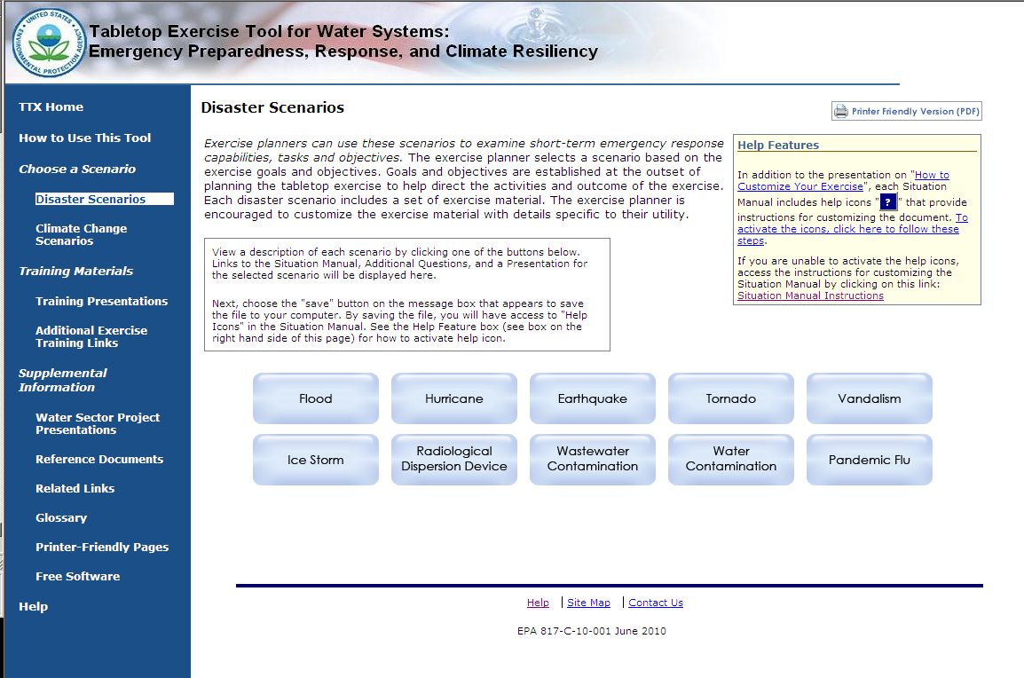
Tabletop Exercise Tool for Water Systems:
Choosing a Scenario
Notes:
The first step in planning a TTX is to select a scenario. Here we are on the “Disaster Scenario” page. We’ve included a 10 different disaster scenarios so the user can select a scenario that is relevant to their region, and objectives for the exercise.
Now we’re going to select a scenario to take a closer look at some of the materials included in the tool for each scenario.

Slide 17
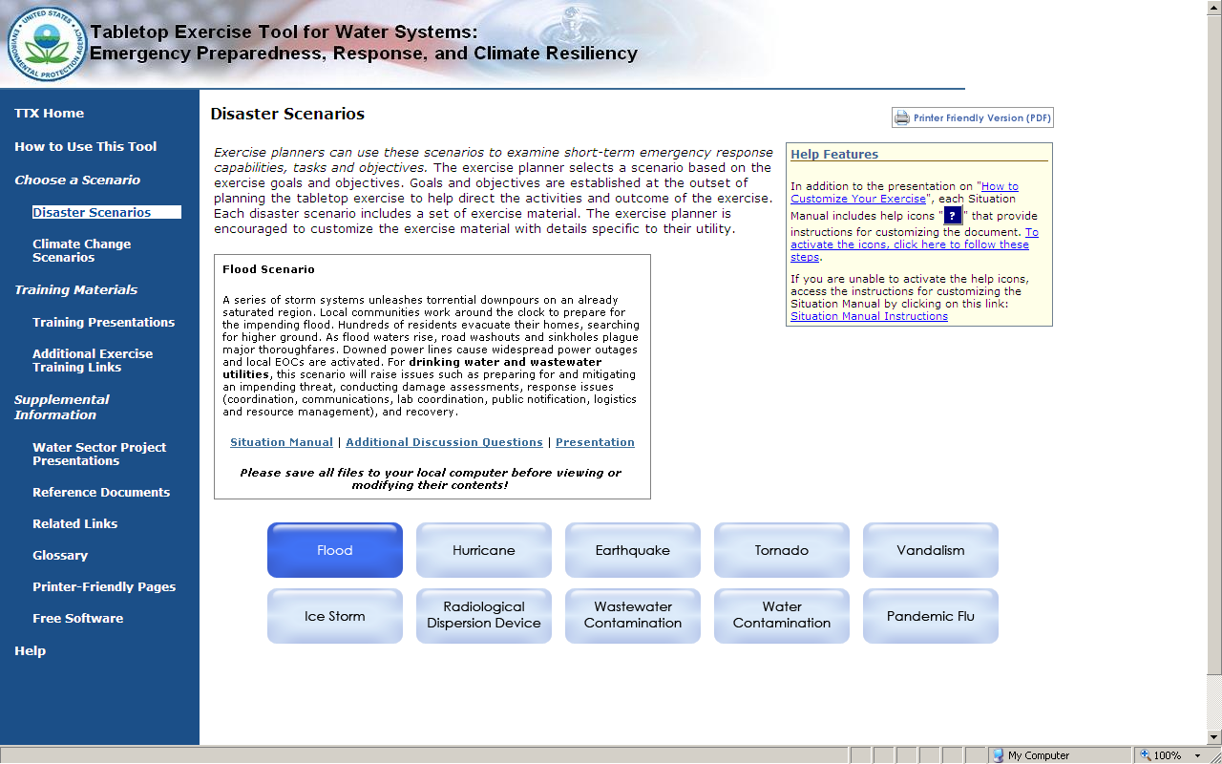
Tabletop Exercise Tool for Water Systems: Customizable Materials
- Macros guide users through design process
- Scenario Description
- Discussion Questions & Key Issues
- Action Planning Session Materials
- Reference Materials
Specific to both drinking water and
wastewater utilities
- Divided into eight categories
- Accompanies SitMan
Users can add images and other
relevant information
Notes:
You can see that after selecting a scenario (here, we’ve selected “Flood”), you can see that a brief description of the scenario shows up in this box. In the box are also links to the customizable SitMan, Additional Discussion Questions, and PowerPoint presentation. Here you can see some of the different features of each of the materials.
The Situation Manual (or SitMan) contains the actual scenario, background technical information, discussion questions, as well as evaluation and action planning materials.
For example, pulling from the additional discussion questions helps the exercise planner guide the discussion in any way they choose, in order to meet their exercise objectives.
The PowerPoint presentation serves to accompany the SitMan during the exercise. Users can customize this presentation by adding utility-specific information, as well images and other details.
All of these materials were developed to be very inclusive, they essentially have all of the information a utility would need to conduct an exercise. This way, a utility would not need to generate new information, they would simply need to take out whatever was not relevant to their exercise.
5/26/2011
17

Slide 18
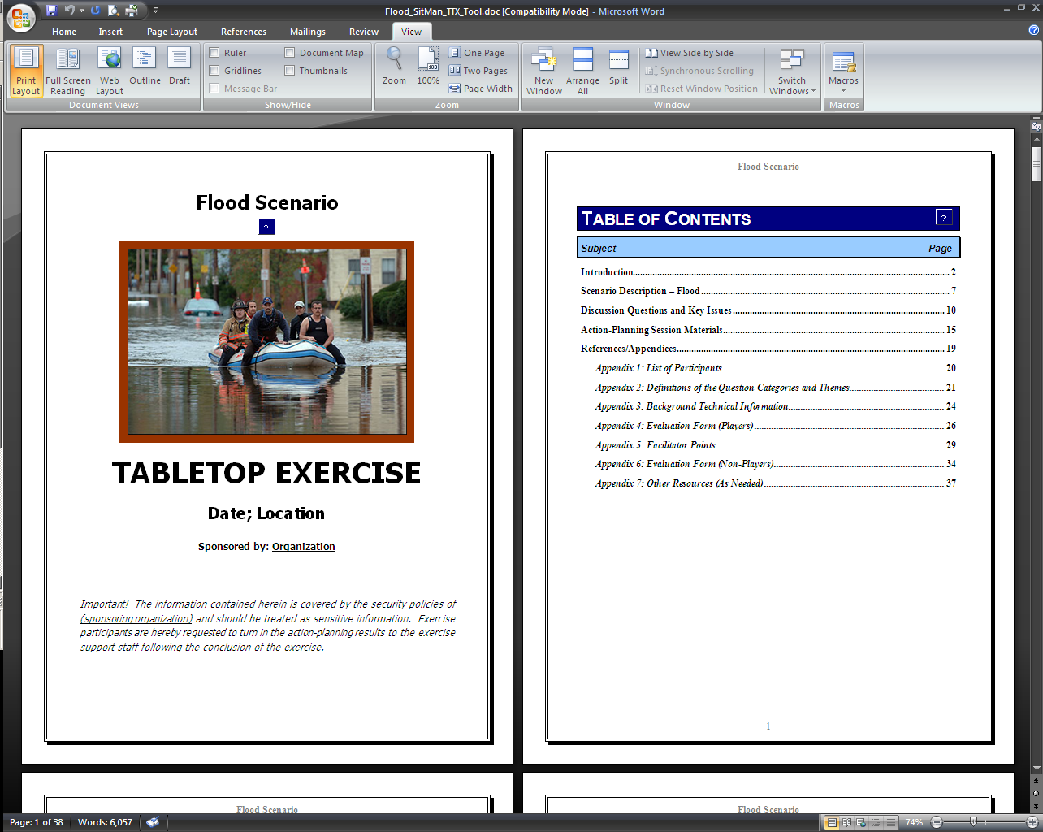
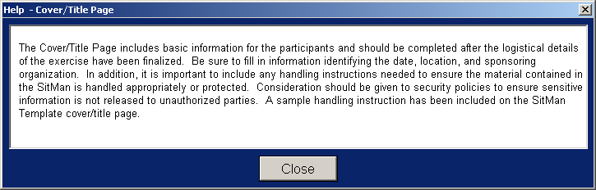
Tabletop Exercise Tool for Water Systems:
Customizable Situation Manual
18
Notes:
Taking a look at the Table of Content, there is a lot of different information, everything the facilitator would need to conduct and evaluate a tabletop exercise. There’s a scenario description, discussion questions and key issues, action planning materials, and a number of reference information.
If you’ll take a look here at this question mark box—these are Macros, and they are inserted throughout the SitMans. Clicking on them will open up a dialogue box that contains instructions on how best to customize that section of the SitMan. This particular macro provides information on the customizing the Cover Page.

Slide 19
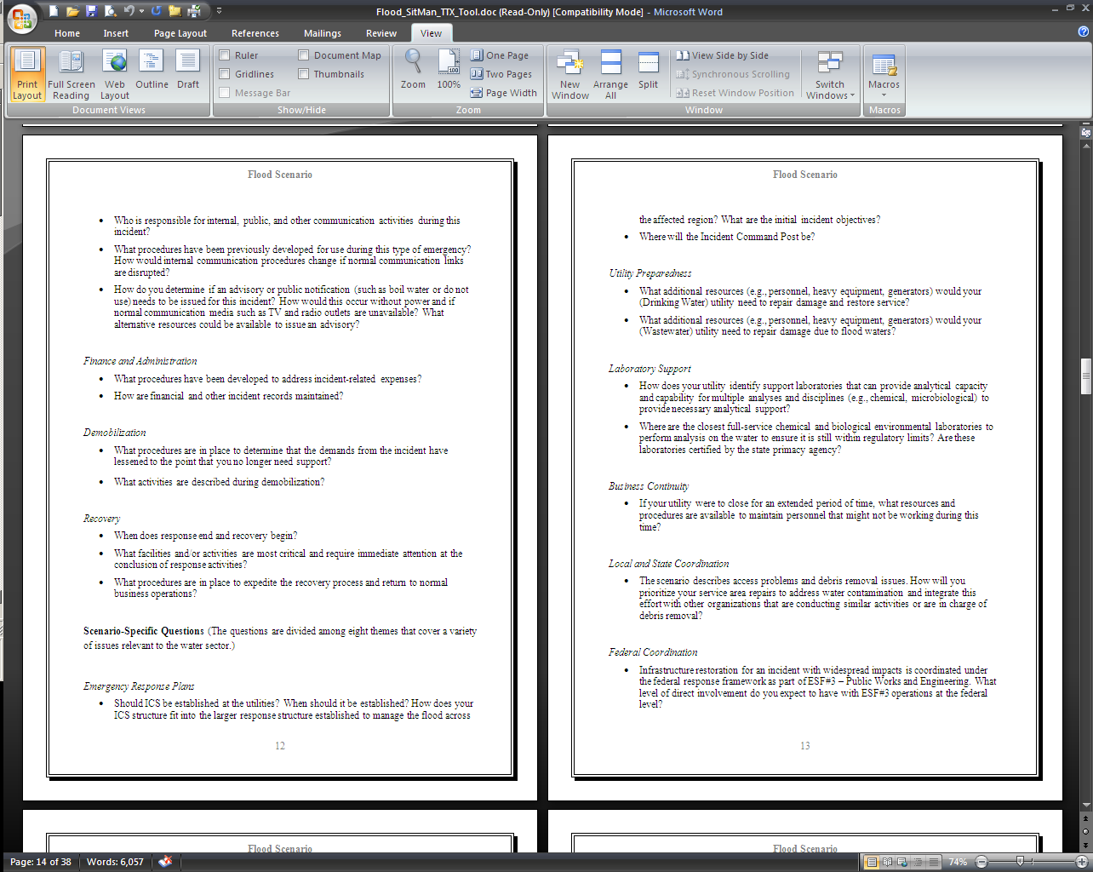
Tabletop Exercise Tool for Water Systems:
Customizable Situation Manual
Notes:
Going to the discussion questions, you can see there are a number of different categories to choose from, allowing you to tailor your exercise to meet your needs. The Situation manuals were designed to contain all of the information you would need to run an exercise—so the user would only need to remove the information and questions they did not want to include, instead of coming up with entirely new information.

Slide 20
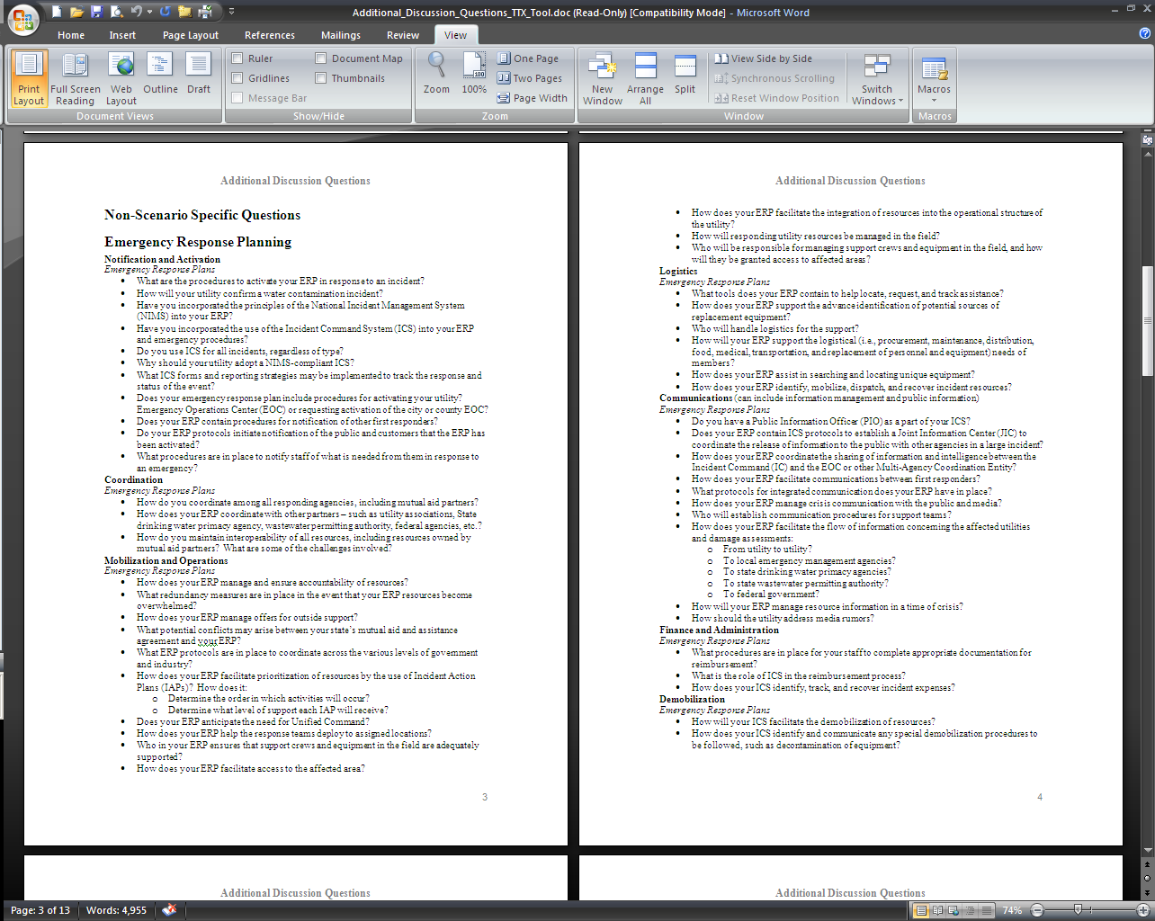
Tabletop Exercise Tool for Water Systems:
Additional Discussion Questions
Specific to both drinking water and
wastewater utilities
- Divided into eight categories
20
Notes:
Going back to the Choose a Scenario page, let’s click on the Additional Discussion Questions.
This is just two pages of the thirteen page document that contains nothing but discussion questions the facilitator can pull from in order to exercise particular aspects of the utility’s Emergency Response Plan.
These questions are divided into eight categories: Emergency Response Planning, Utility Preparedness, Laboratory, Business Continuity Planning, Local and State Coordination, Mutual Aid and Assistance, Law Enforcement and Security, and Federal Coordination.
These eight categories are further divided into eight subcategories: Notification and Activation, Coordination, Mobilization and Operations, Logistics, Communications, Finance and Administration, Demobilization, and Recovery.
5/26/2011
20

Slide 21
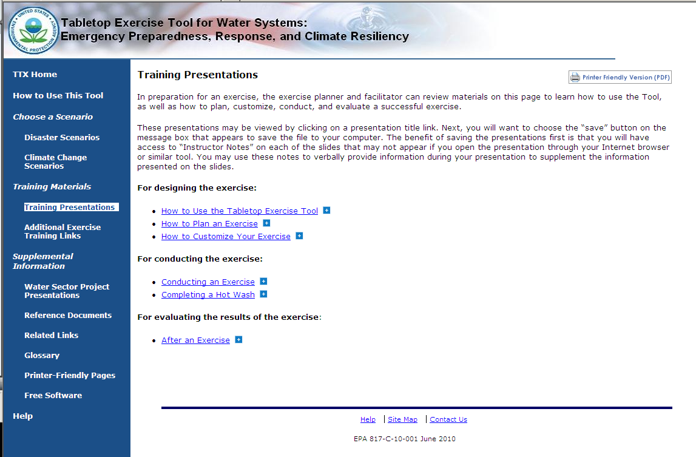
Tabletop Exercise Tool for Water Systems:
Training Presentations and Resources
Text
Notes:
In addition to the “How to Use This Tool” presentation, there are a number of other training resources available on the TTX Tool. Going to the Training Presentations page, you can see that there are PowerPoint presentations on how to plan, customize, conduct, and evaluate your tabletop exercise. These presentations really help to guide users through the entire process of building an effective exercise.

Slide 22
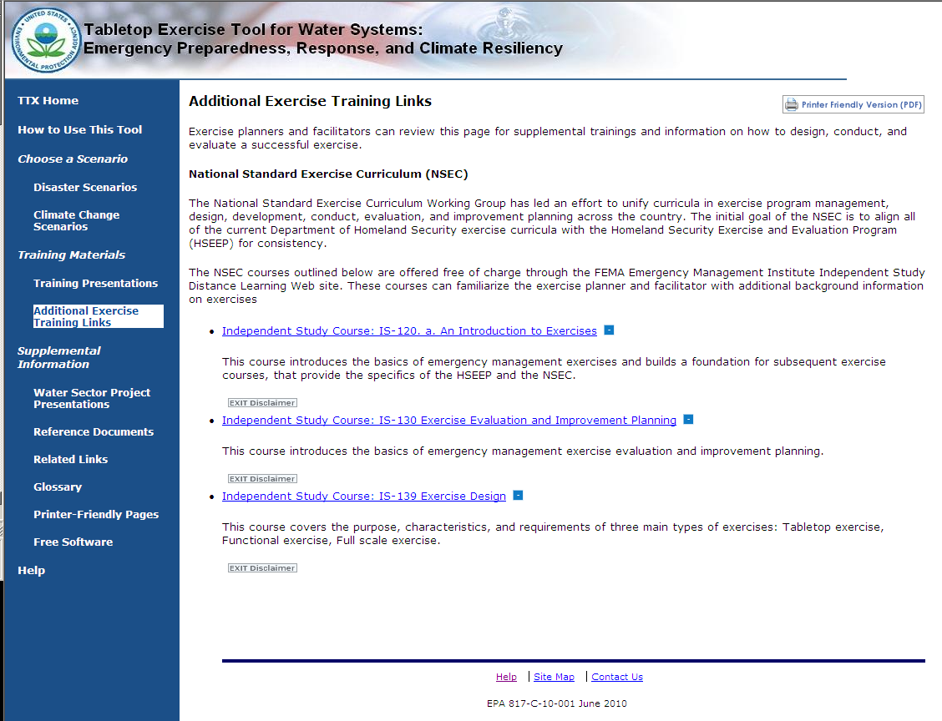
Tabletop Exercise Tool for Water Systems:
Training Presentations and Resources
Text
Notes:
We have also included a number of links to FEMA Independent Study courses on exercising. Clicking on these links will direct the user to FEMA’s website where they will be able to take the course, and get credit for its completion. Again, all of the resources included in the tool really aim to help the user become a seasoned tabletop exercise planner and facilitator.

Slide 23
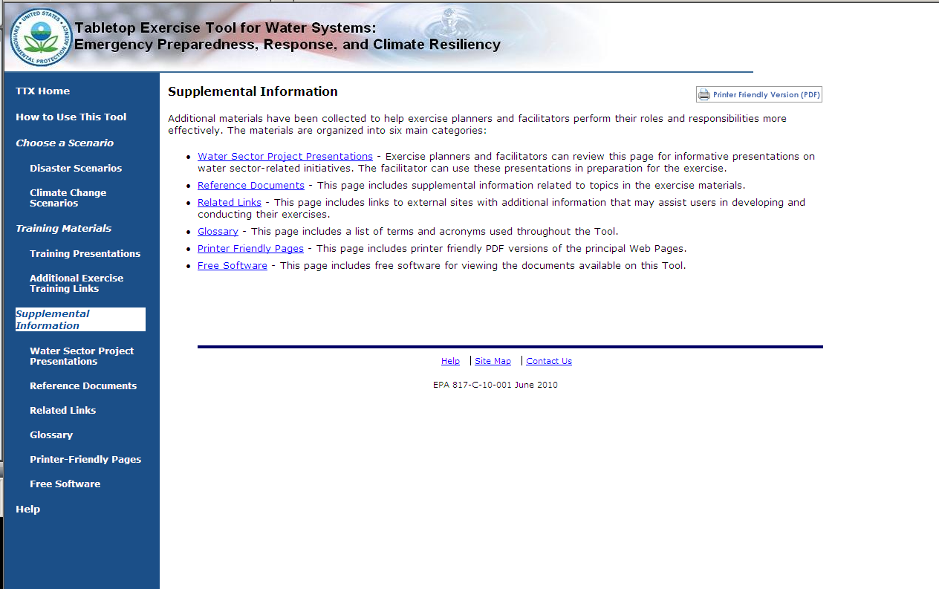
Tabletop Exercise Tool for Water Systems:
Supplemental Information
Notes:
The pages under the “Supplemental Information” heading provide additional resources that contain information on other Water Sector initiatives, documents, and webpages that can be used by the exercise designer/facilitator to build a more comprehensive TTX. We’re going to give a brief overview of those pages now.

Slide 24
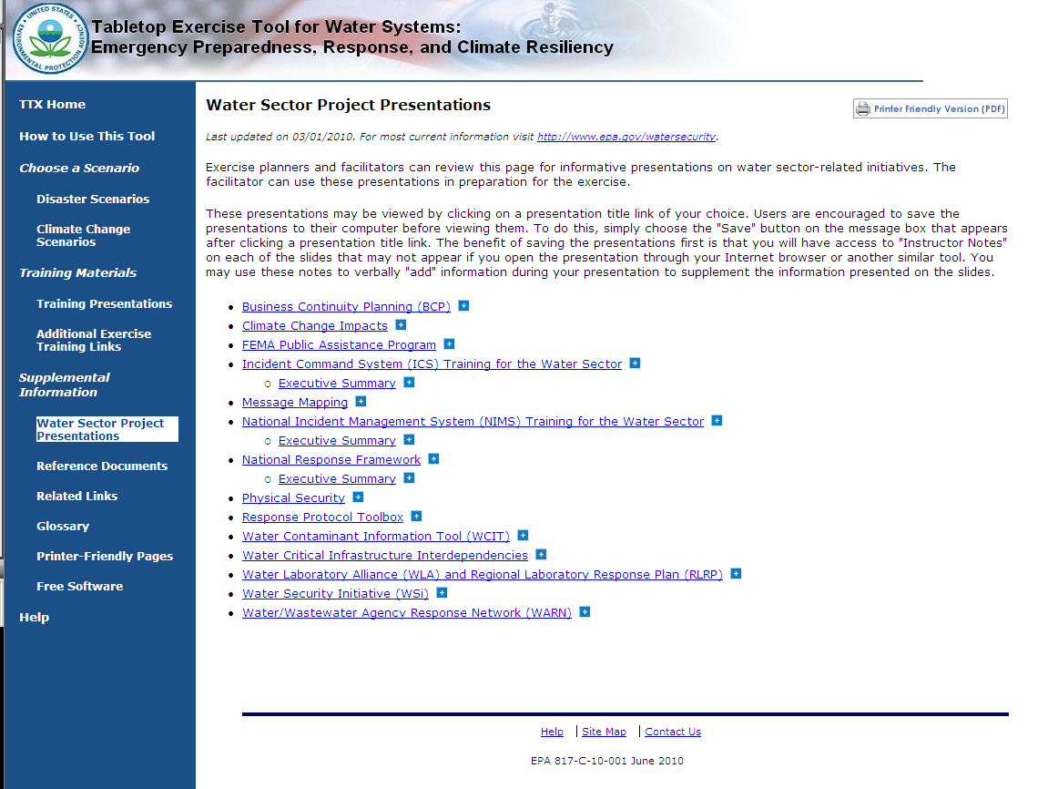
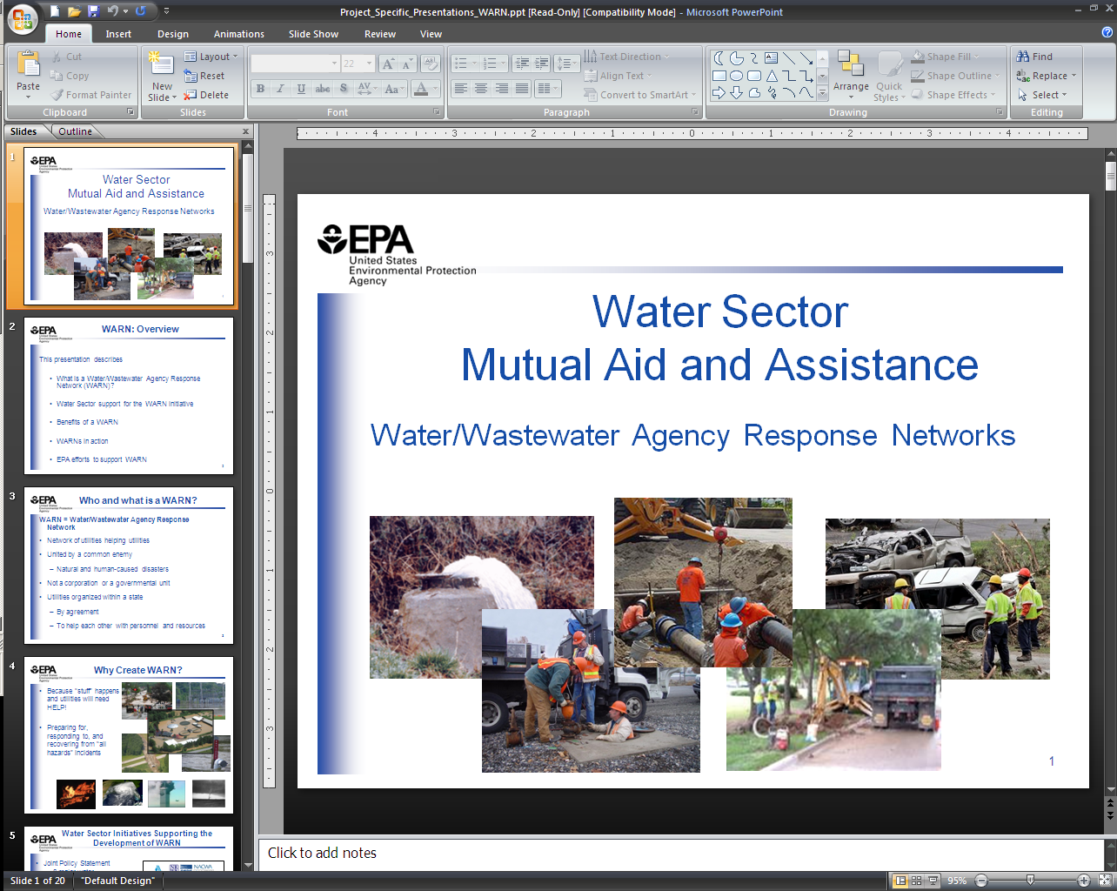
Tabletop Exercise Tool for Water Systems:
Water Sector Project Presentations
Text
Notes:
Clicking on the Water Sector Project Presentations link, will bring you to this page.
Here you can see that PowerPoint presentations on current EPA Water Sector Initiatives are listed. Users can view these presentations to learn more about a particular topic, to give a presentation to exercise participants at some point during the exercise, or to reference the benefits of a program during the exercise itself.
For example, if the exercise facilitator wanted the participants to discuss Mutual Aid and Assistance during the exercise, they could open the WARN presentation and find out more information, and how to incorporate it in their discussions.

Slide 25
Poll Question
If you are from a water or wastewater utility, are you a member of your state’s WARN?
Yes
No
My state does not have a WARN yet
For more information about WARNs, go to www.NationalWARN.org

Slide 26
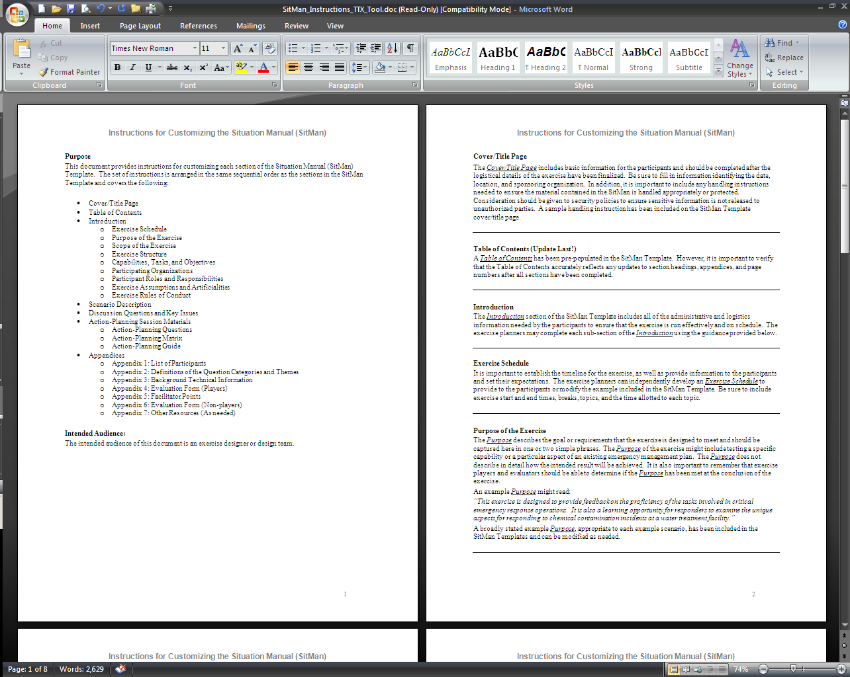
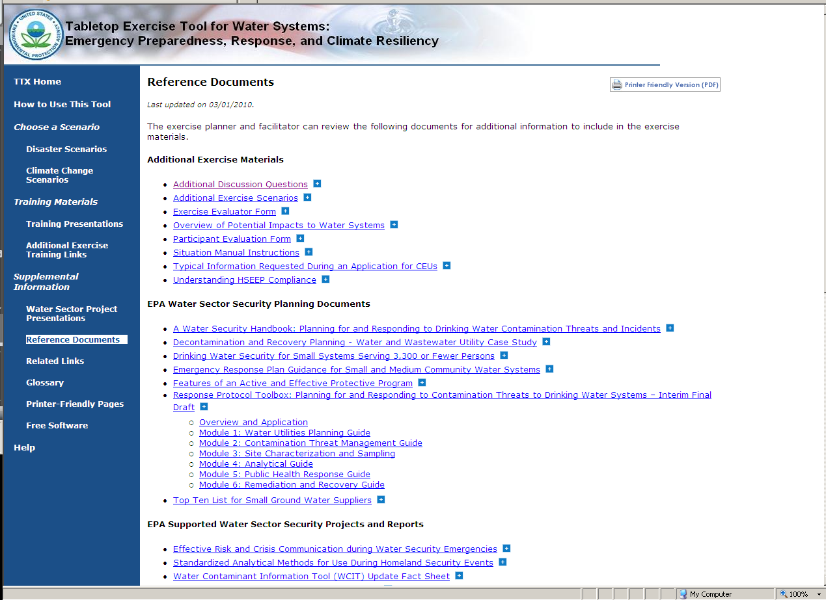
Tabletop Exercise Tool for Water Systems:
Reference Documents
Notes:
The Reference Documents Page lists a number useful published documents that provides a great deal of background information on the Water Sector. There are a number of categories of documents on this page:
Additional Exercise Materials lists Microsoft Word versions of documents related to or included in the tool. Clicking on “Situation Manual Instructions” opens up the Word version of the instructions included in the Situation Manual macros.
Other categories include:
EPA Supported Water Sector Security Projects and Reports;
Water Sector Mutual Aid and Assistance Documents;
Climate Change information related to the Water Sector; and
National Level Planning Documents (such as applicable HSPDs, the Water SSP, and the National Response Framework)

Slide 27
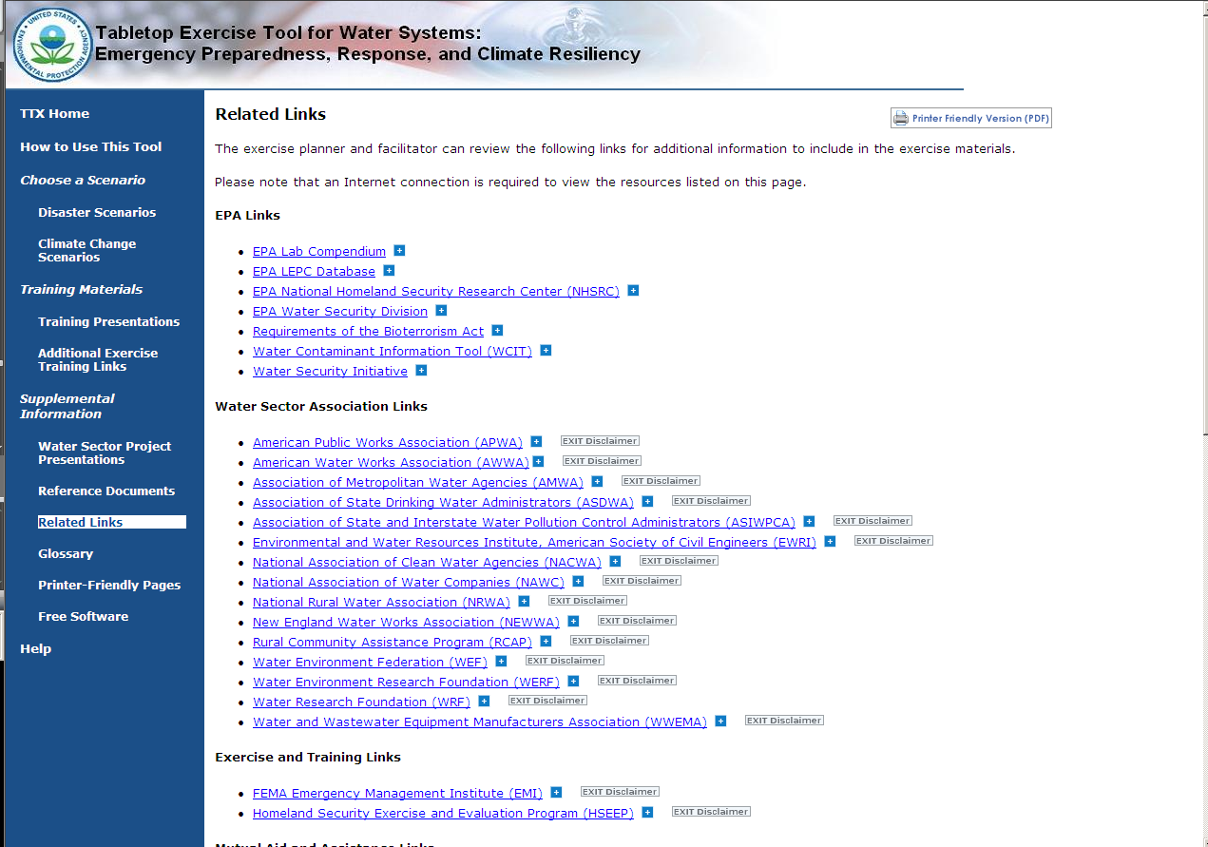
Tabletop Exercise Tool for Water Systems:
Related Links
Notes:
The related links page lists EPA links, such as the Water Security Division’s webpage; Water Sector Associations; also links to training and exercise resources (such as a link to HSEEP, which provides docment templates and more information on exercise planning), mutual aid and assistance, climate change, and links to other federal agencies.

Slide 28
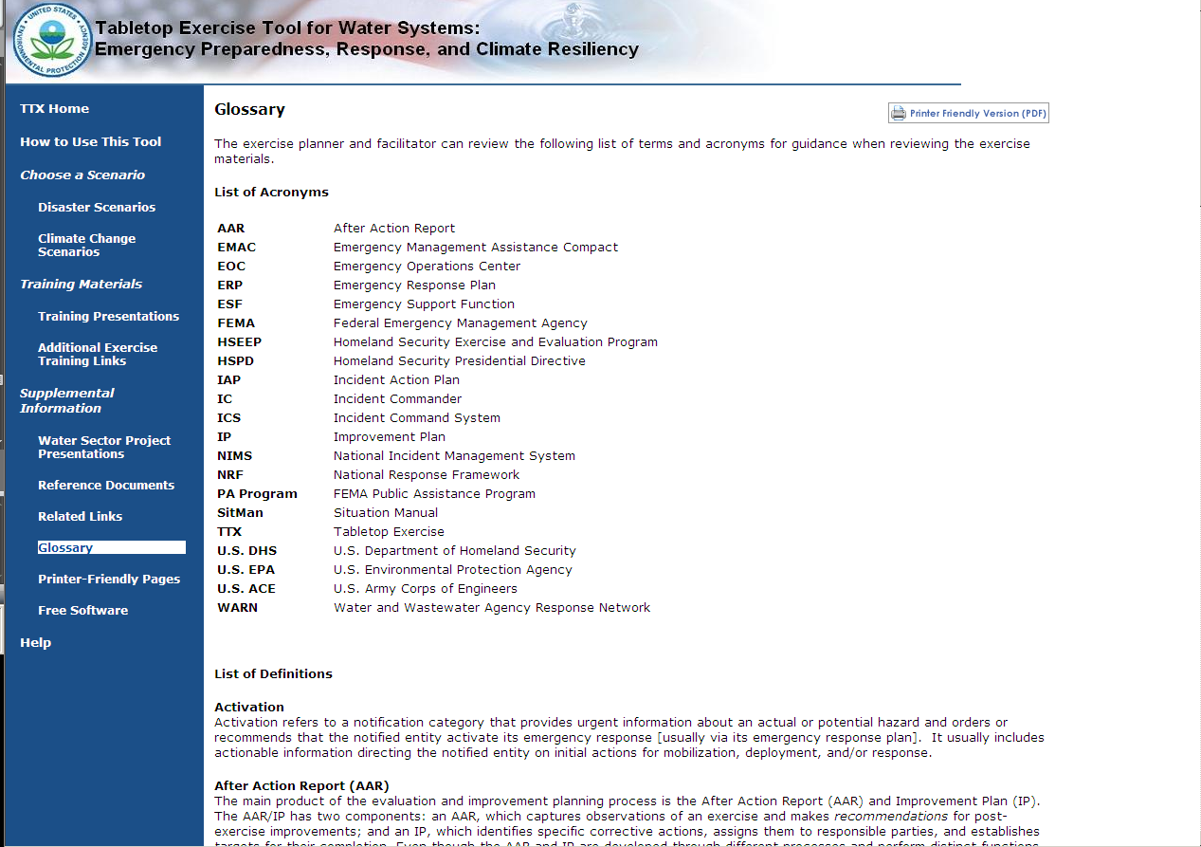
Tabletop Exercise Tool for Water Systems:
Glossary
Notes:
We have also included a glossary that contains a list of acronyms and definitions of terms used throughout the TTX Tool.

Slide 29
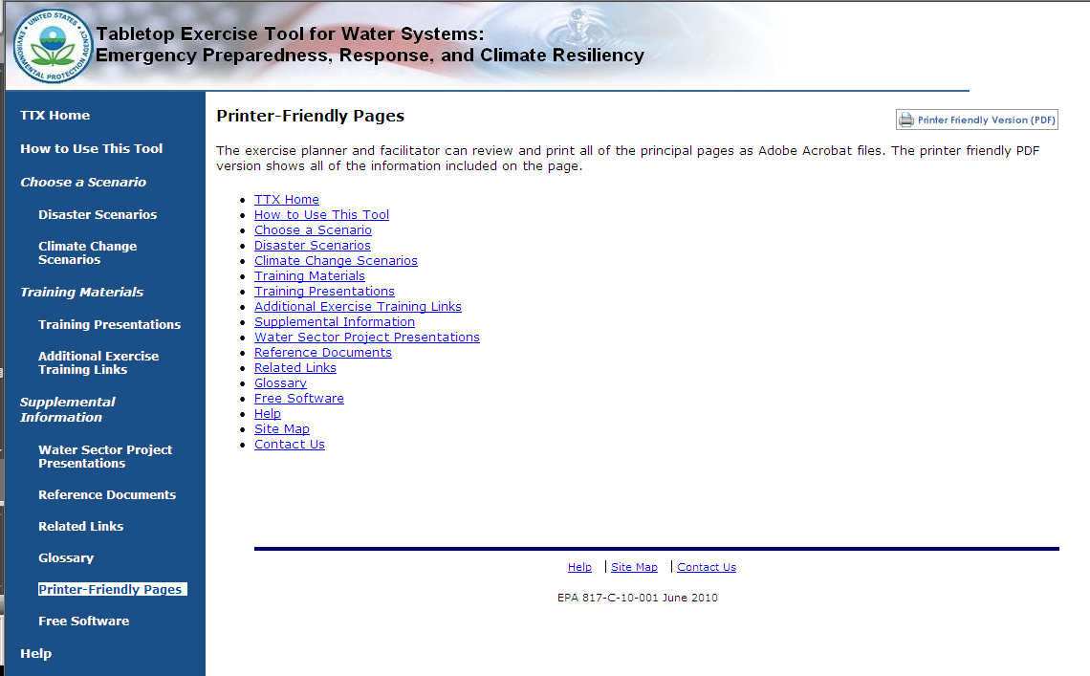
Tabletop Exercise Tool for Water Systems:
Printer-Friendly Pages
Notes:
Here on this page, you will find links to the PDF versions of all of the pages in the TTX Tool. Printing these pages will allow you to get all of the benefits of the tool without sitting in front of your computer. You can find a “Printer Friendly Version” icon on each page of the TTX Tool in the upper right-hand corner.
Clicking on the “Glossary” link, you’ll see the PDF version open automatically.

Slide 30
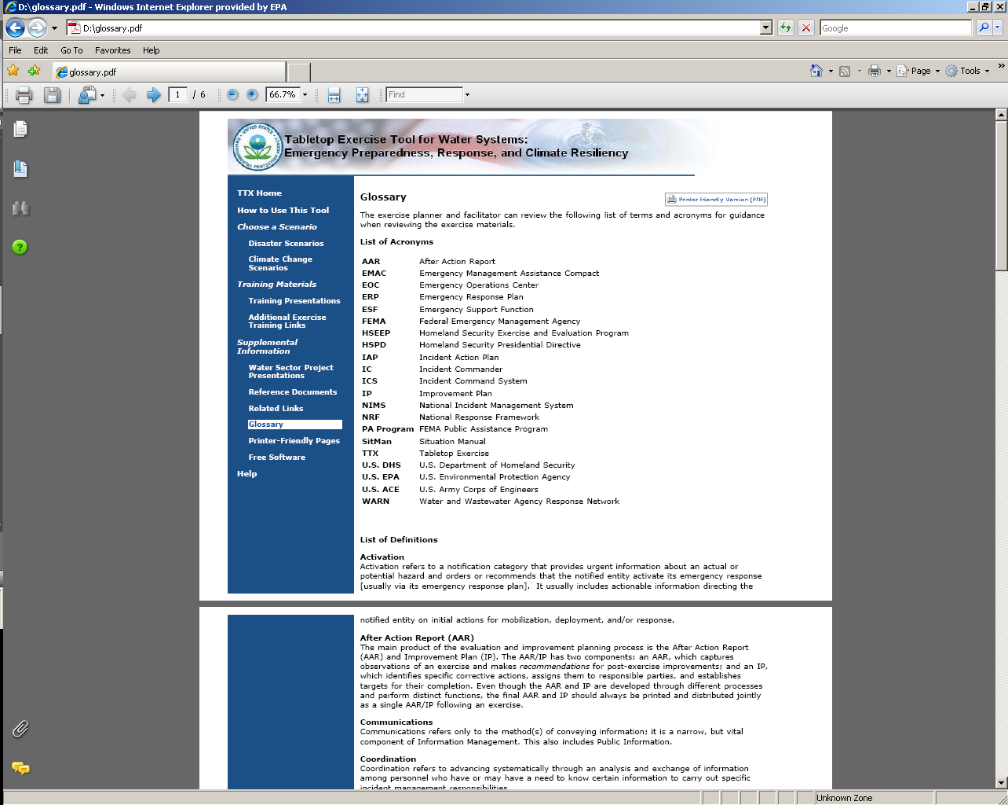
Tabletop Exercise Tool for Water Systems:
Printer-Friendly Pages

Slide 31
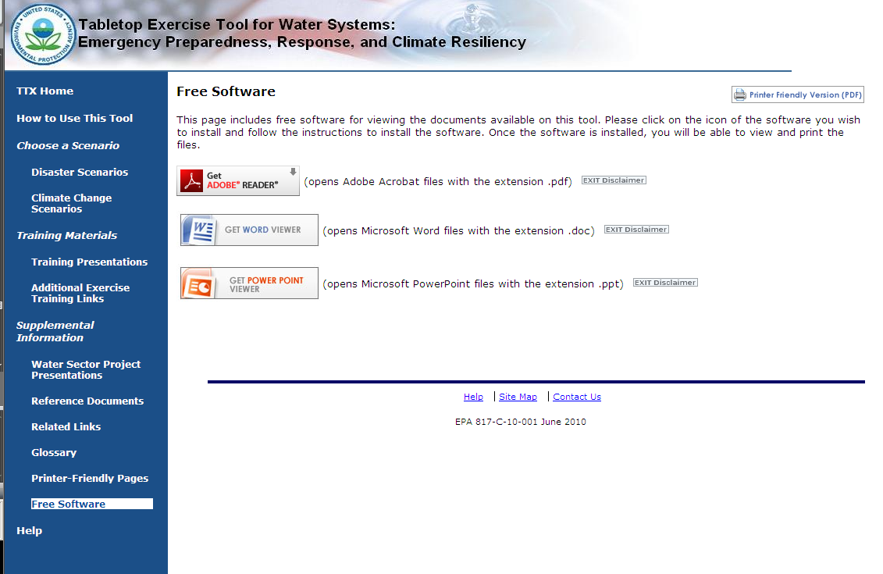
Tabletop Exercise Tool for Water Systems:
Free Software
Notes:
The “Free Software” page links you to programs such as Word and PowerPoint viewer that will allow you to access all of the documents included in the TTX Tool even if you do not have the appropriate programs downloaded to your PC.

Slide 32
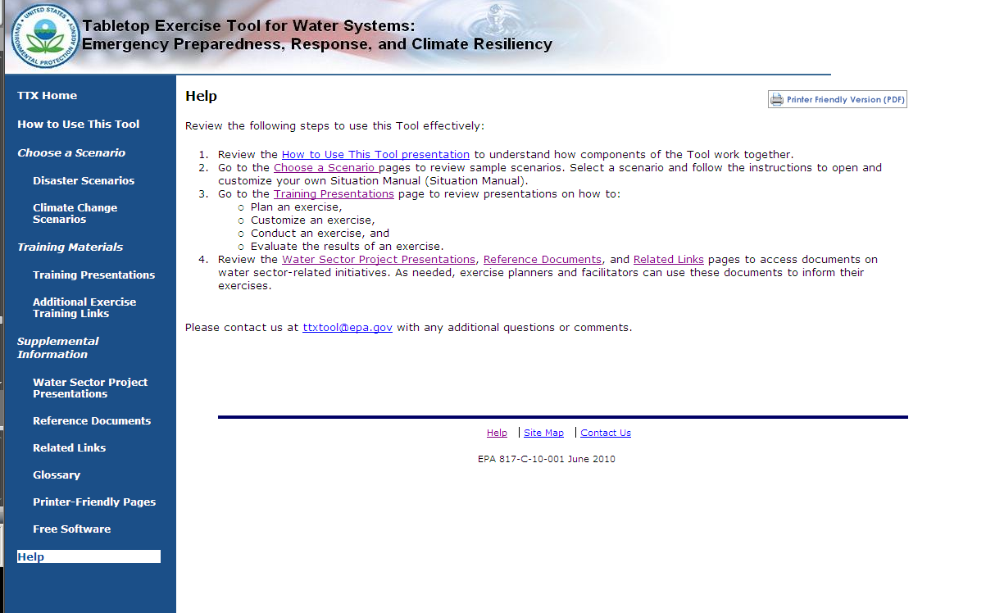
Tabletop Exercise Tool for Water Systems:
Help Page
Notes:
The Help page provides links to presentations and pages within the tool to help users get started. It also includes a link to an email address users can write to if they have any questions or feedback. There is a link to the Help page (as well as a Site Map and a Contact Us page) at the bottom of each page in the tool.

Slide 33
TTX Tool Outreach and Training
Download the TTX Tool at http://yosemite.epa.gov/ow/SReg.nsf/description/TTX_Tool
Available on the WaterISAC portal, keyword “TTX Tool”
Request physical copies* by emailing ttxtool@epa.gov
Train-the-Trainer Workshops
  Planned for Montana, Tennessee, Florida, Missouri, and Massachusetts
  Register at www.horsleywitten.com/ttxtool
*Physical copies of the tool will not work in a Mac computer
Notes:
Link to download the TTX Tool or to request physical copies.
Placeholder slide for the training in June.

Slide 34
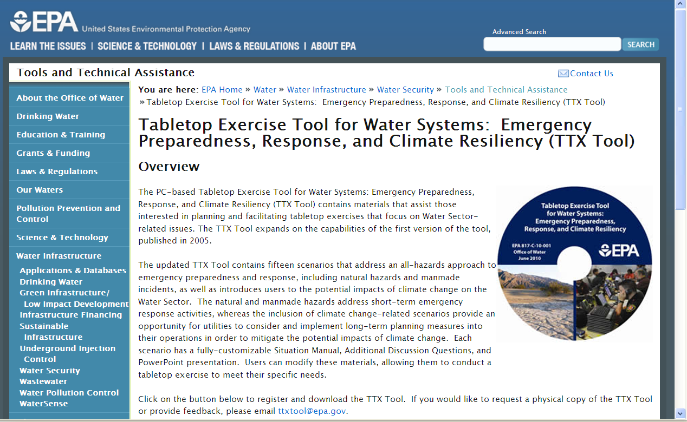

Slide 35
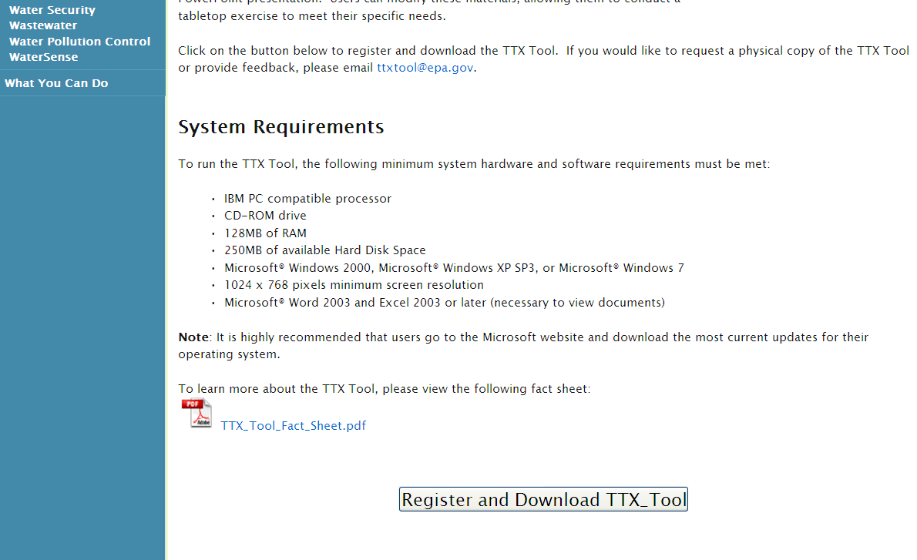
Remember, if you request a hard copy of the tool, it cannot go into a Mac!

Slide 36
Contact Information
John Whitler, whitler.john@epa.gov
Amy Posner, posner.amy@epa.gov
Caitlin Stormont, stormont.caitlin@epa.gov
Tom Noble, tnoble@horsleywitten.com
Your feedback and questions: ttxtool@epa.gov
U.S. EPA Water Security Division:
http://water.epa.gov/infrastructure/watersecurity
To learn more about customizing and conducting a TTX, please attend the June 2nd webinar
Notes:
Link to download the TTX Tool or to request physical copies.
Placeholder slide for the training in June.

Slide 37
For a limited time, the U.S.
Environmental Protection Agency is offering FREE 12-month subscriptions to WaterISAC Pro.
Benefits of WaterISAC PRO
Who Should Subscribe?
Latest, sensitive information about critical infrastructure protection
Emergency management resources
Alerts about emerging risks
Direct access to contaminant databases
Intelligence analysts who help interpret and evaluate threats
Free webcasts on current water security topics
Utility staff
Information security staff
Public health officials
Relevant local, state and federal personnel
Emergency response staff
Infrastructure protection managers
Water quality personnel
Association staff
Law enforcement and intelligence personnel
Subscribe at www.WaterISAC.org
Upgrade an existing account at www.WaterISAC.org/manage
Email us at info@waterisac.org or analyst@waterisac.org
Notes:
37

Slide 38
U.S EPA’s Tabletop Exercise Tool for Water Systems: Emergency Preparedness, Response, and Climate Resiliency – Training Webinar
Notes:
38

