Slide 1
Hazard Mitigation Assistance
June 17, 2014
Federal Insurance & Mitigation Administration

Slide 2
Presentation Overview
  Hazard Mitigation Assistance (HMA)
    Program Requirements
    Eligible Applicants
    Funding
  Water Sector and Utility Projects
    How to get involved?
    Tools, Training, Resources
  Benefit Cost Analysis
    Loss of Services: Utilities
    New:
      Eco-System Services Benefits
      Sea Level Rise

Slide 3
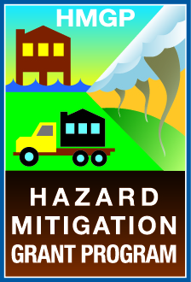
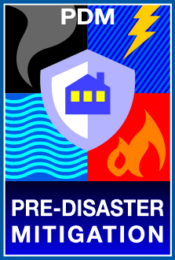

HMA Grant Programs
  Robert T. Stafford Act Grant Programs
    Hazard Mitigation Grant Program (HMGP)
    Pre-Disaster Mitigation (PDM)
  National Flood Insurance Program (NFIP) Grant Program
    Flood Mitigation Assistance (FMA)
      Repetitive Flood Claims (RFC) – Eliminated by BW12
      Severe Repetitive Loss (SRL) – Eliminated by BW12

Slide 4
Programmatic Requirements
Cost Effectiveness
Feasibility & Effectiveness
Hazard Mitigation Plan
Environmental Planning & Historic Preservation
National Flood Insurance Program

Slide 5
Eligible Applicants and Subapplicants
  Applicants
    State agencies
    Tribal governments
  Subapplicants
    State agencies
    Tribal governments
    Local governments/communities
    Private non-profit organizations (HMGP only)

Slide 6



Federal-State-Local Framework
  Local governments apply for assistance and grants
  State governments assist locals, review grants, and submit applications to FEMA; all applications must go through the State for prioritization before submission to FEMA
  FEMA reviews grant applications and makes funding determinations; also provides technical assistance to States and locals upon request

Slide 7
HMGP Overview
HMGP may become available after a Presidential Major Disaster Declaration
Provides 75% federal funding to implement long-term, cost-effective mitigation measures
Grantees (States, Tribes, Territories) set priorities prior to submitting applications to FEMA
Allocated during the immediate recovery period
Based on sliding scale of estimated aggregate amount of disaster assistance.

Slide 8

HMGP Application Timeline

Slide 9
HMGP projects

Slide 10
HMGP Funding FY13 and FY14
            In FY 2013, more than $701 million in HMGP program funds were obligated
            In FY 2014, $333 million has been obligated (as of March 26, 2014)
*11.8 Billion available since 1989

Slide 11


PDM and FMA Funding FY13 and FY14
            PDM
              FY 2013, $25 Million
              FY 2014, $25 Million
*$1.04 Billion available since 2002
            FMA
              FY 2013, $120 Million
              FY 2014, $100 Million
*$1.09 Billion available since 1996
(Includes former RFC and SRL programs)

Slide 12
Pre-Disaster Mitigation Program (PDM)
  Annually funded (by Appropriation) pre-disaster grant program not tied to disasters
  FY 14 application period open until July 25, 2014.
  Goal is to reduce overall risk to the population and structures from future hazard events
  Funds are awarded on a nationally competitive basis; though there is also a State set-aside
  In general, provides 75% federal funding
  PDM funds multihazard mitigation projects and mitigation plans

Slide 13
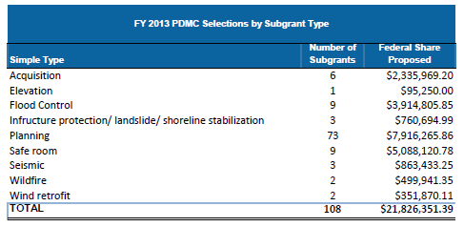
FY13 PDM Application Period

Slide 14
Flood Mitigation Assistance Program (FMA)
  Annually funded grant program by Appropriation
  FY14 application period open until July 25, 2014
  Goal of reducing or eliminating claims under the National Flood Insurance Program (NFIP), Funded by the National Flood Insurance Fund (NFIF)
  Properties must have NFIP insurance coverage
  Cost-share is dependent on NFIP loss history:
    up to 100% for severe repetitive loss properties
    up to 90% for repetitive loss properties (FMA Definition)
    Up to 75% for insured properties

Slide 15
FY13 FMA Application Period
  Applicants submitted1,718 properties for FMA funding
      547 SRL properties submitted
  FEMA selected projects containing 516 properties
      428 SRL properties selected

Slide 16
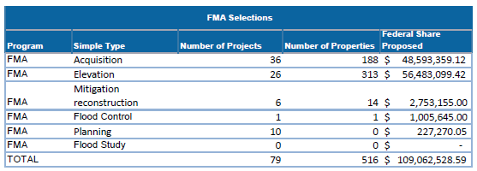
FY13 FMA Application Period

Slide 17
PDM and FMA application timeline
*PDM has a 2 yr period of performance.
*FMA has a 3 yr period of performance.

Slide 18
Water & Utility Mitigation:
Flood Protection:
  Elevation of Components (above the 500 year floodplain)
  Dry Floodproofing
  Minor Flood Control Projects
  Drainage Projects:
    Storm Water Management Detention and Retention Ponds
    Sewage Backflow Prevention Valves
    Culvert Upgrades
    Bar Screen Cleaners

Slide 19
Water & Utility Mitigation
Multi-Hazard Mitigation:
  Generators
    and related wiring, hookups, or transfer switches
  Wind Retrofits
  Seismic Retrofits
  Burial of utility lines
    wind/winter storms
  Safe Rooms
    for critical facility operators

Slide 20
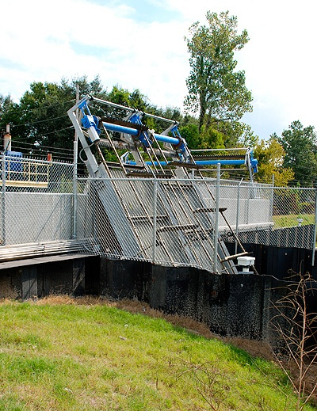
Mitigation can be…
A Bar Screen Cleaner
Automatic bar screen cleaners function to remove trash and green debris from the pump’s intake
This station pumps 93,000-gallons-per minute & includes two 36-inch pumps and one 30-inch pump.
Helps move rainwater out of a nearby subdivision more efficiently.

Slide 21

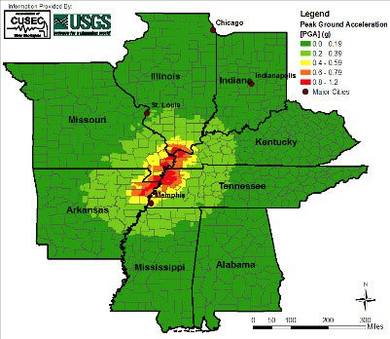
Mitigation can be…
A pump station seismic retrofit
The MLGW retrofit included:
reinforcing and anchoring masonry walls;
strengthening steel frames;
improving the connection of concrete wall and roof;
securing anchorage of pipes and valves,
and bracing of pipelines; and
bracing of treatment and control equipment;

Slide 22
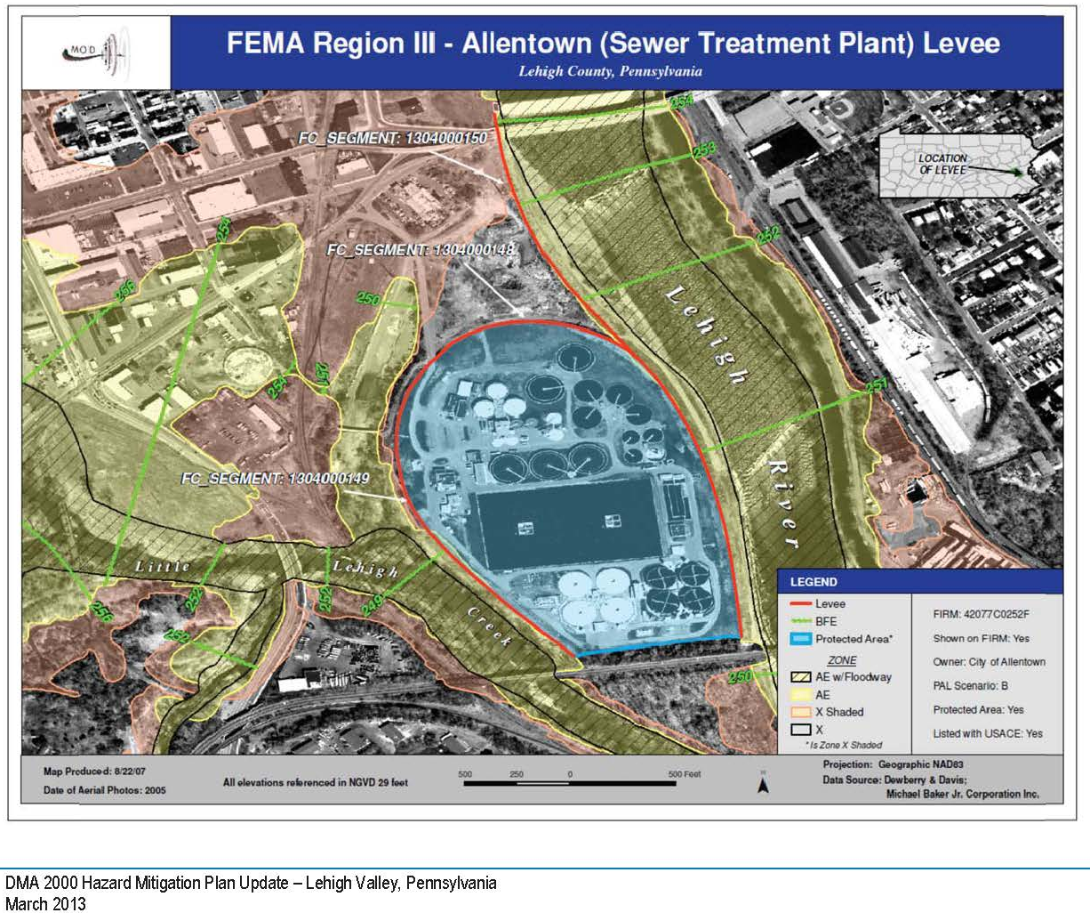
How do I get involved?
Participate in the planning process.
Communities must have local plans to be eligible for funding.
Plans are required to be updated every 5 years.
Contact your State Hazard Mitigation Officer (SHMO) to express interest and to learn about State priorities.

Slide 23
For More Information
Specific criteria for each HMA program:
http://www.fema.gov/hazard-mitigation-assistance
Contact your State Hazard Mitigation Officer:
http://www.fema.gov/state-hazard-mitigation-officers

Slide 24
Available Training Programs
Unified HMA: Developing Quality Application Elements (E212)
Unified HMA: Application Review and Evaluation (E213)
Unified HMA: Project Implementation and Programmatic Closeout (E214)
Benefit-Cost Users Workshop (E275)
Benefit-Cost Analysis: Entry-Level Training (E276)
Managing Floodplain Development Through the National Flood Insurance Program (NFIP) (E273)
Retrofitting Flood-Prone Residential Buildings (E279)
Residential Coastal Construction (E386)
Mitigation Planning for Local and Tribal Communities (IS-318)
Advanced Floodplain Management Concepts (E194)
Advanced Floodplain Management Concepts II (E282)
Advanced Floodplain Management Concepts III (E284)
National Flood Insurance Program/Community Rating System (NFIP/CRS) (E278)
Notes:
States can request classes for State staff and subapplicants. Many online training courses are available.

Slide 25
Technical Assistance
Ongoing technical assistance will be provided as-needed.
  eGrants
  Engineering feasibility
  Benefit-Cost Analysis (BCA)
  Environmental/Historic Preservation
  Project technical assistance help lines
    Technical Assistance for HMA grant programs
      1.866.222.3580
      hmaprogram@fema.dhs.gov
    FEMA eGrants Helpdesk
      1.877.611.4700
  EHP eLearning Tool
    http://www.fema.gov/environmental-planning-and-historic-preservation-program/elearning-tool-fema-grant-applicants-45

Slide 26
Technical Documents
  FEMA has published many technical documents to assist States and communities to promote sustainable community development and mitigation practices
  FEMA Document Library
    http://www.fema.gov/about-fema-library
  FEMA Building Science Website
    http://www.fema.gov/building-science

Slide 27
Benefit Cost Analysis Updates
    Loss of Services: Utilities
    New:
      Eco-System Services Benefits
      Sea Level Rise

Slide 28
FEMA Standard Values for
Loss of Services for Utilities:
Loss of | Per Person / Per Day
Electric Power | $131
Potable Water | $103
Wastewater | $45

Slide 29
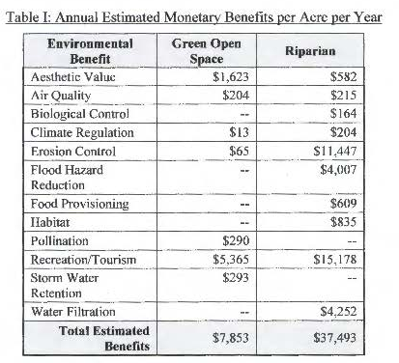
Eco System Service Benefits
Policy allows the consideration of Environmental Benefits in the evaluation of acquisition projects.
These additional benefits are calculated based on the square feet of land being deed restricted.
Policy restricts inclusion of the ecosystem service benefits.

Slide 30
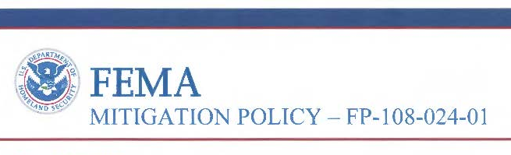
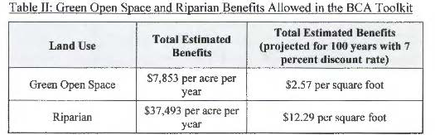
Future losses avoided or “benefits” must equal or exceed the mitigation project cost.
Benefits/costs= Benefit Cost Ratio (BCR)
Environmental benefits are available after a .75 BCR.

Slide 31
Incorporating Sea Level Rise
A memo was released on December 23, 2013 that allows for the inclusion of sea level rise estimates.
The memo and frequently asked questions (FAQs) include sources of information for sea level rise
  NOAA
  USACE
  Locally generated studies that have been accepted and adopted by the state or jurisdiction.
Including sea level rise estimates can substantially increase a projects benefit cost ratio and level of protection, especially for acquisition projects and projects with a useful life of 30 or more years.

Slide 32
Incorporating Sea Level Rise
    Developed methodology to include and allow estimated sea level rise adjustments in analysis
    Primarily applicable to coastal areas
    No software change required, as the hazard data is adjusted
      Add estimated sea level rise on top of current
      10-, 50-, 100-, and 500-year flood elevations
      Can substantially increase benefits, especially for acquisition projects

Slide 33
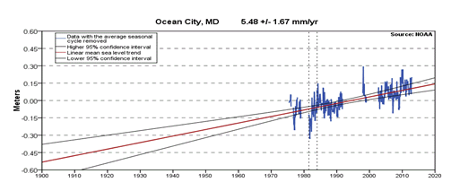
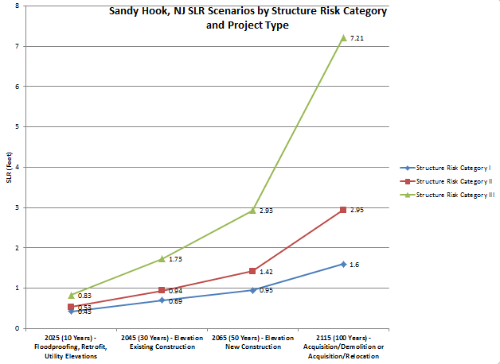
Use of SLR information is optional.
NOAA
USACE

Slide 34
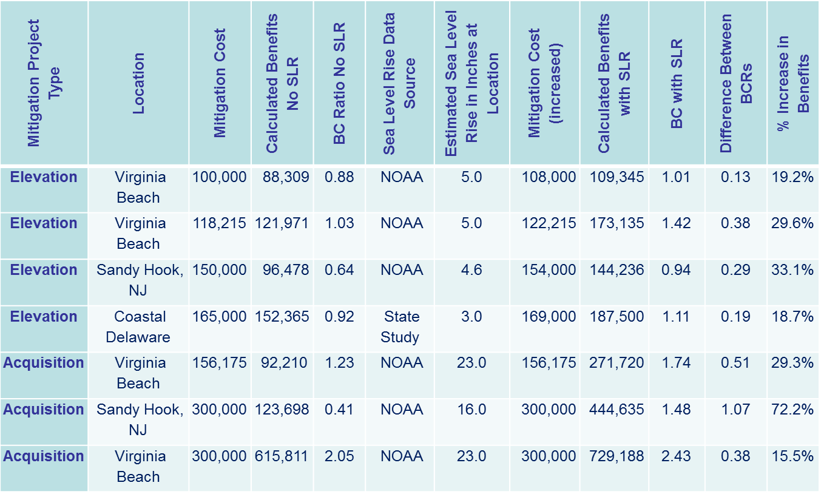
Incorporating Sea Level Rise

Slide 35

Questions?
www.fema.gov/hazard-mitigation-assistance

