Slide 1
Water ISAC
ICS-CERT Assessment Offerings
Matthew McWhirt, Technical and Field Assessments
Industrial Control Systems Cyber Emergency Response Team (ICS-CERT)
National Cybersecurity and Communications Integration Center (NCCIC)
Notes:
1

Slide 2
Where there is a wire, there is a way
A skilled and well resourced adversary who is determined to get into your network will find a way.
You should have two goals:
  Make the task of intrusion as difficult as possible on the adversary
    Increases likelihood of detection
    If successful, there should be more clues to help in containment and recovery
    The adversary may give up! (You win… for now)
  If or when the intrusion succeeds, be able to detect and contain

Slide 3
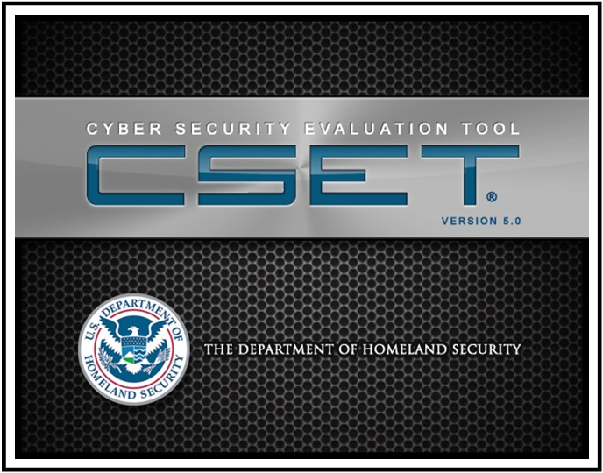
Risk Reduction Products
Based on industry standards
Capability:
  Creates baseline security posture
  Provides recommended solutions to improve security posture
  Standards specific reports
  (e.g., NERC CIP, DOD 8500.2, NRC, NEI, NIST SP800-53, CSF)
  Repeatable and Measurable results
  Downloadable from DHS website
https://ics-cert.us-cert.gov/Downloading-and-Installing-CSET
Notes:
3

Slide 4
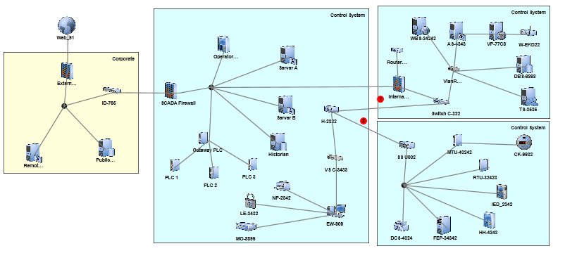
Design Architecture Reviews
“Deep-dive” Network Architecture Review and Analysis
  Review of all egress and ingress
  Network perimeter defenses
  Data flow and information sharing
  Proper communication channels

Slide 5
Design Architecture Review Checklist
Network Diagram Review Zoning – Logical & Physical Switches/Routers ACLs VLANs Sub netting Port Security DMZs Signature Analysis
Hardware Data Diode IDS/IPS Firewalls Packet filtering Rules – Configuration Hardware Known Vulnerabilities
Software Configuration file Whitelisting/Blacklisting Host Based Firewalls Packet filtering Software and Firm Known Vulnerabilities
Monitoring Log’s – Central log servers IDS/IPS – alerts Anti-Virus
Remote Access How, what, where, when, Policies 3rd Party access (vendors, contractors) Maintenance and support Network Perimeter
Media Protections/Policies
Policies & Procedures Staffing Rules and Responsibilities Background Checks Self Audits, cybersecurity testing Configuration Management (Patch & Updates) Backup Policies
Physical Protection – Inspections (walk down perimeter defenses) Location of Equipment

Slide 6
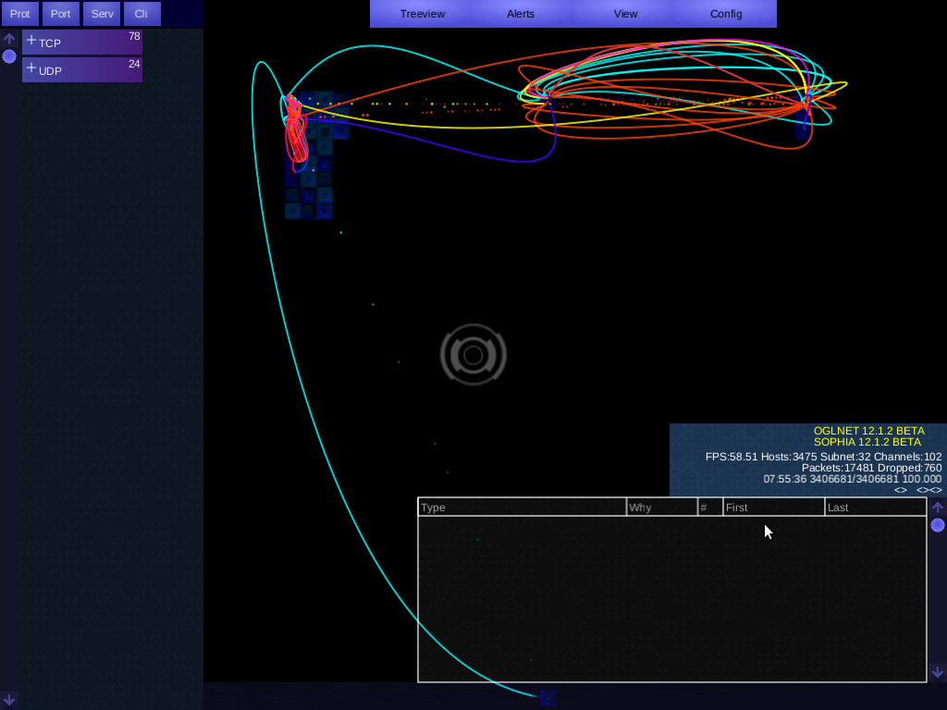
Network Analysis
Network Architecture Verification & Validation
(NAVV)
  NAVV Benefits:
  TCP Header Data Network Capture
  Point-to-Point Communication Verifications
  Data Flow Validation
  Network Perimeter Protection

Slide 7
Data Protected through DHS PCII
The Protected Critical Infrastructure Information (PCII) Program, part of the Department of Homeland Security (DHS) National Protection and Programs Directorate, is an information-protection program created to enhance information sharing between the private sector and the government.

Slide 8
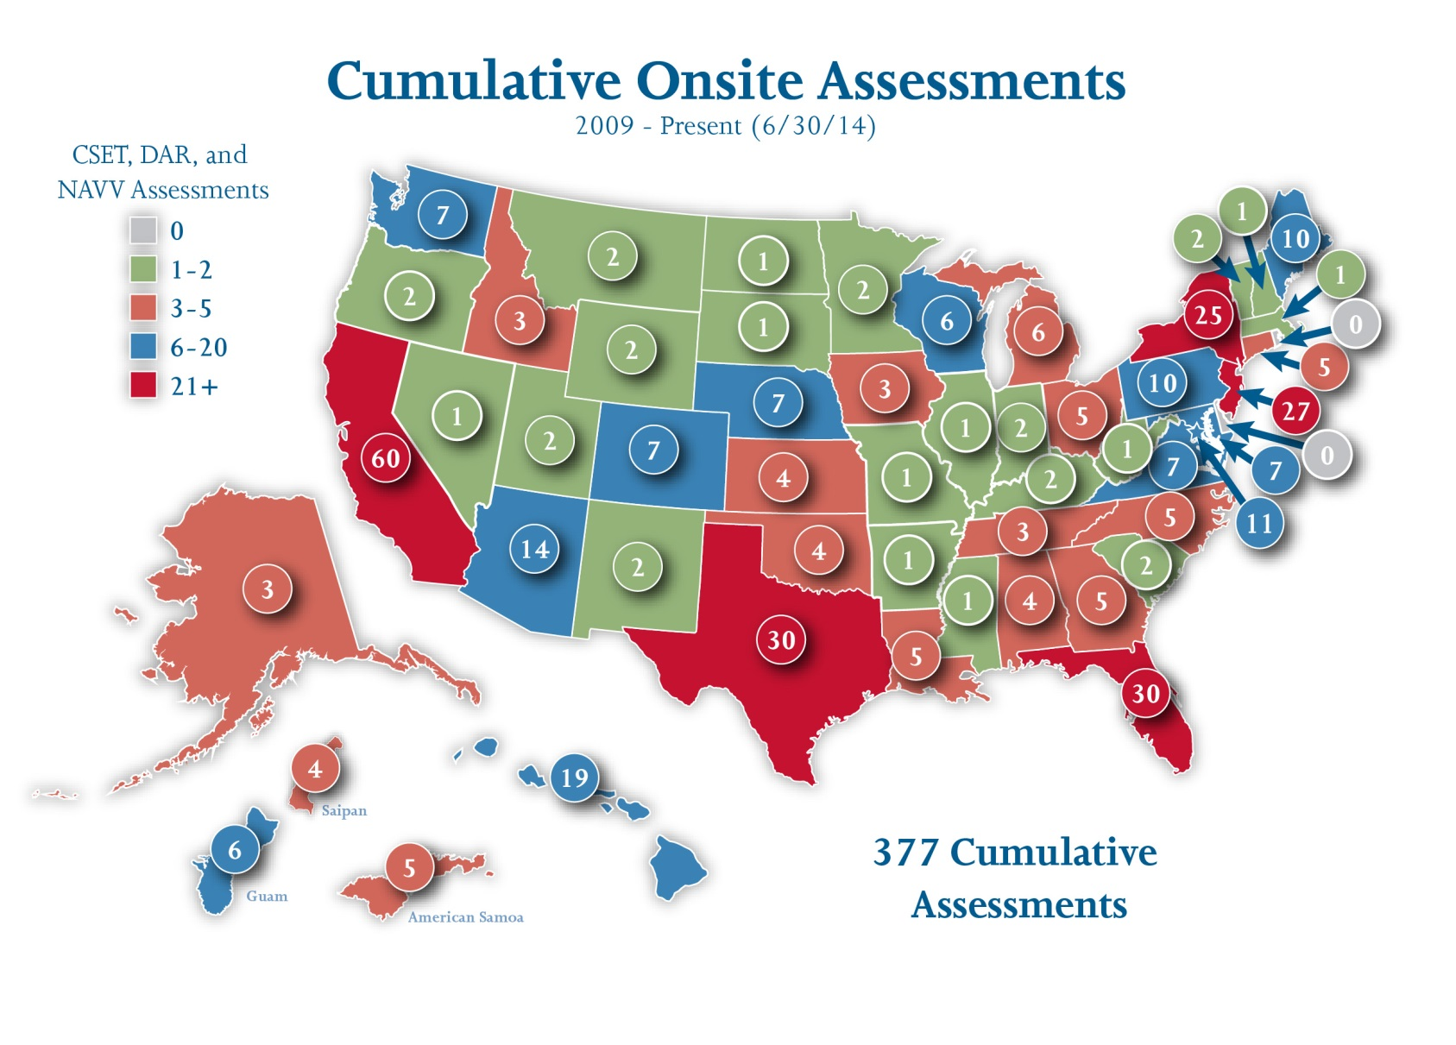
Cumulative Onsite Assessments – (Thru 6/30/14)

Slide 9
Cumulative Onsite Assessments – (Thru 6/30/14)
Sector | Fiscal (FY)Year Assessments |  |  |  |  |  | Totals by Sector
 | 2009 | 2010 | 2011 | 2012 | 2013 | 2014
Agriculture & Food |  | 0 | 5 |  |  |  | 5
Banking & Finance |  | 2 | 1 | 6 |  |  | 9
Chemical |  | 3 | 1 | 4 |  |  | 8
Commercial Facilities | 1 |  | 8 | 2 |  |  | 11
Communications |  |  | 2 |  | 2 |  | 4
Critical Manufacturing |  | 2 | 4 | 1 |  |  | 7
Dams |  | 1 |  |  |  |  | 1
Defense Industrial Base | 1 | 1 |  | 12 | 1 |  | 15
Emergency Services |  |  | 2 | 5 |  |  | 7
Energy | 2 | 12 | 10 | 7 | 19 | 14 | 64
Government Facilities | 1 | 6 | 7 | 2 | 2 | 4 | 22
Healthcare & Public Health | 2 | 5 | 7 |  | 5 |  | 19
Information Technology | 1 |  | 3 | 3 | 2 |  | 9
Nuclear Reactors, Materials & Waste |  |  | 1 | 7 | 8 | 3 | 19
Transportation Systems | 2 | 5 | 9 | 13 | 10 | 10 | 49
Water | 10 | 20 | 21 | 27 | 23 | 27 | 128
Total by Year / Cumulative | 20 | 57 | 81 | 89 | 72 | 58 | 377

Slide 10

Cyber Resilience Review: capability maturity evaluation method for critical infrastructure
Kevin Dillon
Branch Chief, Stakeholder Risk Assessment and Mitigation
Office of Cybersecurity and Communications (CS&C)
U.S. Department of Homeland Security (DHS)

Slide 11
C³ Voluntary Program
Critical Infrastructure Cyber Community or C³ (pronounced “C Cubed”) Voluntary Program was created to assist the enhancement of critical infrastructure cybersecurity and to encourage the adoption of the National Institute of Standards and Technology’s (NIST) Cybersecurity Framework (the Framework), released in February 2014.
The C³ Voluntary Program will:
  Support industry in increasing its cyber resilience
  Increase awareness and use of the Framework
  Encourage organizations to manage cybersecurity as part of an all hazards approach to enterprise risk management
Visit us at www.dhs.gov/ccubedvp, or www.us-cert.gov/ccubedvp
  Check out the website, download and use the messaging kit, and reach out to the different programs for support
  Try out the CRR and reach out if you have questions on the methodology or need assistance

Slide 12

Overview
What is the Cyber Resilience Review (CRR)?
  A voluntary assessment
  A method that examines cybersecurity practices in critical infrastructure organizations
  Evaluates the operational resilience of a specific critical service
  Measures the execution of key practices and the institutionalization of processes
  Provides participants with a detailed report containing options for consideration
  Utilizes the goals and practices found in the CERT Resilience Management Model (CERT-RMM)
  Available in two versions:
  - A self-assessment kit
  - A facilitated workshop conducted in one day (typically 6–8 hours) [data gathered on-site is protected under the DHS PCII Program]
Notes:
Suggest that participants start thinking about how they will use the model

Slide 13

What Is Cyber Resilience?
“… the ability to prepare for and adapt to changing conditions and withstand and recover rapidly from disruptions. Resilience includes the ability to withstand and recover from deliberate attacks, accidents, or naturally occurring threats or incidents…”
- Presidential Policy Directive – PPD 21
February 12, 2013
Protect (Security) | Sustain (Continuity)
Perform (Capability) | Repeat (Maturity)
Notes:
You must consider the operational risks to your organization
People’s actions
Systems and technology failures
Failures of internal processes
External events
A framework is needed to put all these factors into a useable form
Must enable measurement
Should improve confidence in organization’s ability to respond to the risks
Key terms:
Survivability: The capability of a system to fulfill its mission in a timely manner, even in the presence of attacks or failures (including large scale natural disasters)
Disruption Tolerance: allows an organization to more realistically assess its operational risks and make strategic decisions for continuation of operations in the face of natural or man-made challenges / the ability for selected functions to continue to operate even when the supporting infrastructure is not operating at an optimum level
The quadrant at the bottom of the slide shows
“Protect” which requires controls (or security measures) to be in place to protect assets important in the delivery of a service
“Sustain” requires that plans be made to enable an organization to continue service delivery during times of significant disruption.
“Perform” requires that the organization have the capabilities to perform the tasks required for protection and sustainment.
“Repeat” means the organization has in place the infrastructure and processes that enable people to successfully respond to issues in an organized and repeatable manner.

Slide 14
Cyber Resilience Value Proposition: What’s in It for Me?
Resilience management provides support to manage complex cybersecurity challenges.
Efficiency: not too much and not too little; resilience equilibrium
  balancing risk and cost
  getting the most bang for your buck
  achieving compliance as a by-product of resilience management
Roadmap: what to do to manage cybersecurity; flexibility and scalability
  using an overarching approach - which standard is best
  deciding what versus how to manage cybersecurity risk
Cybersecurity ecosystem: addressing the interconnectedness challenge
  managing dependencies
  addressing both internal and external organizational challenges and silos

Slide 15
Ten Domains of Cybersecurity Capability
The ten domains in the CRR represent important areas that contribute to the operational resilience of an organization.
The domains focus on practices that an organization should have in place for the protection and sustainment of its critical service.
CRR Domains
AM | Asset Management
CCM | Configuration and Change Management
RM | Risk Management
CTRL | Controls Management
VM | Vulnerability Management
IM | Incident Management
SCM | Service Continuity Management
EXD | External Dependencies Management
TA | Training and Awareness
SA | Situational Awareness

Slide 16
Cyber Resilience Review (CRR) Domains
Key Attributes of a Cyber Resilience Program
Asset Management Know your assets (people, information, technology, facilities) being protected & their requirements, e.g., Confidentiality, Integrity, Availability | Risk Management Know your biggest risks and address them in a manner that considers cost and your risk tolerances
Configuration and Change Management Manage asset configurations and changes | Service Continuity Management Ensure workable plans are in place to manage disruptions
Controls Management Manage and monitor controls to ensure they are meeting your objectives | Situational Awareness Actively discover and analyze information related to immediate operational stability and security
External Dependencies Management Know who your most important external entities are and manage the risks they pose to essential services | Training and Awareness Ensure your people are trained on and aware of cybersecurity risks and practices
Incident Management Be able to detect and respond to incidents | Vulnerability Management Know your vulnerabilities and manage those that pose the most risk

Slide 17
Cyber Resilience Review by the Numbers
42
Goals
141
Specific Practices
10
Domains
13
Maturity Indicators
per domain
271
Total Questions
Notes:
9.7 SPs per PA
3.6 SGs per PA
2.7 SPs per SG

Slide 18
Process Institutionalization in the CRR
Maturity indicator levels (MIL) are used in the CRR to measure process institutionalization
Level 5-Defined
Processes are defined, measured, and governed
Level 4-Measured
Higher degrees of institutionalization translate to more stable processes that
  produce consistent results over time
  are retained during times of stress
Level 3-Managed
Level 2-Planned
Practices are performed
Level 1-Performed
Practices are incomplete
Level 0-Incomplete
Notes:
MIL 2 = Documented Plan & Policy, Stakeholders identified and aware of roles, standards & guidelines identified and implemented
MIL 3 = Management oversight of the performance, qualified staff been assigned to perform activity, adequate funding, risk related to the performance of the activity
MIL 4 = are activities periodically reviewed and measured to ensure they are effective and producing intended results, activities reviewed to ensure they adhere to plan, higher level mgt aware of issues related to performance of activity
MIL 5 = has organization adopted a standard definition of the activity from which operating units can derive practices, are improvements to the activity documented and shared across the organization

Slide 19
CRR Self-Assessment Kit
Released in February, 2014 to complement the launch of the NIST CSF
The CRR Self-Assessment Kit allows organizations to conduct a review without outside facilitation.
Contains the same questions, scoring, and reporting as the facilitated assessment.
The kit contains the following resources:
Method Description and User Guide
Complete CRR Question Set with Guidance
Self-Assessment Package (automated toolset)
CRR to NIST CSF Crosswalk
CRR Self-Assessment Kit website:
http://www.us-cert.gov/ccubedvp/self-service-crr
Notes:
Speaker:
This graphic depicts the approach presented during the workshop that organizations can use to build cyber resilience. The phases reflect a service based approach that focuses on assets that support the service. The Process Management and Improvement phase is an underlying phase that focuses on defining and maturing processes that are used to achieve cyber resilience.

Slide 20
Cyber Resilience Review – Self Assessment
Getting Started
Review the CRR Method Description and User Guide
Identify the scope of the CRR Self-Assessment
  Identify critical services to the organization and identify which parts of the organization deliver those services
  Choose a critical service that will be the focus of the self-assessment
  Determine which assets (people, information, technology, and facilities) are required for the delivery of the service
Identify key participants in the self-assessment
  Managers and senior staff-members responsible for the areas of operations and service being assessed (i.e., CIO, CISO, Director of IT, Director of Ops., etc)
  Other stakeholders that can provide answers that best represent the organization’s capabilities in a given CRR domain (i.e., office managers, senior owners and operators, subject matter experts, policy writers, etc.)
  typically 7-10 participants
20

Slide 21
Cyber Resilience Review and the Framework
Relationship between DHS’ Cyber Resilience Review and the NIST Cybersecurity Framework [CRR to NIST CSF crosswalk available]
Identify
Services
Create Asset Inventory
Protect
& Sustain
Assets
Disruption Management
Cyber
Exercise
Identify and prioritize services
Identify assets, align assets to services, and inventory assets
Establish risk management, resilience requirements, control objectives, and controls
Establish continuity requirements for assets and develop service continuity plans
Define objectives for cyber exercise, perform exercises, and evaluate results
Respond
Recover
Identify
Protect
Detect
Process Management and Improvement

Slide 22

Contact Information
To request a facilitated CRR or for general questions contact us at
CSE@hq.dhs.gov
Notes:
22

