Slide 1



U.S EPA’s Tabletop Exercise Tool for Water Systems: Emergency Preparedness, Response, and Climate Resiliency – Training Webinar
June 2, 2011, 3:00 – 4:30 pm EDT
Notes:
1

Slide 2
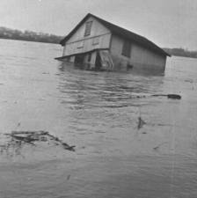
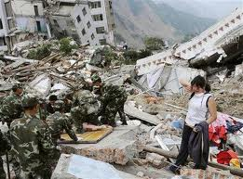
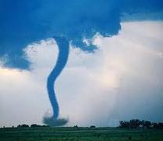
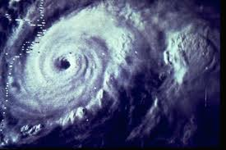
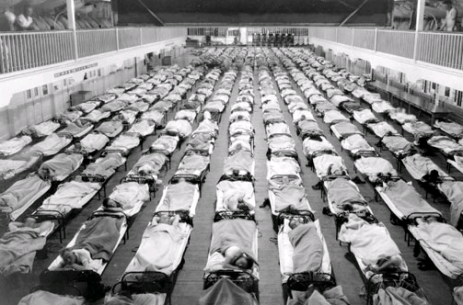
EPA’s Tabletop Exercise Tool for Water Systems: Emergency Preparedness, Response, and Climate Resiliency Webinar
Part II - June 2, 2011

Slide 3
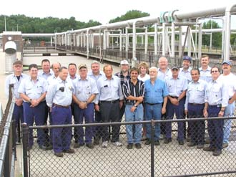
Participant Introductions
Notes:
Additional Information for the user

Slide 4

Webinar Objectives
Demonstrate EPA’s Tabletop Exercise Tool and how it is useful in creating exercises
Give participants the confidence to plan and conduct an exercise
Show participants how to get the Tool
Notes:
Objectives of this training are to familiarize you with the materials on the updated Tabletop Exercise Tool, and better inform of how these materials can be used to customize, plan, facilitate, and evaluate a TTX.

Slide 5
Introduction to Tabletop Exercises

Slide 6

What is an exercise?
Something performed or practiced in order to develop, improve, or display a specific power or skill.
To practice in order to train,
strengthen, or develop.
Notes:
This is the dictionary definition.
Different people define "exercise" in different ways
training and drills (i.e. a noun)
a way to evaluate and confirm the soundness of policies and procedures, through in-depth discussion (i.e. a verb)
An exercise can be all of these-and more.
Take many forms depending on scope and objective of the exercise
Exercises range in cost, scope, complexity, purpose and approach

Slide 7
Why do we exercise?
Evaluate operations and plans
Improve readiness
Clarify roles and responsibilities
Improve performance and coordination
Uncover resource gaps
Identify opportunities for improvement
Notes:
Exercises provide a safe environment to:
Evaluate operations and plans
Improve readiness
Clarify roles and responsibilities
Improve performance and coordination
Uncover resource gaps
Identify opportunities for improvement

Slide 8

Exercise Categories: Discussion-Based
Discussion-based exercises familiarize participants with current plans, policies, agreements and procedures, or may be used to develop new plans, policies, agreements, and procedures.
Notes:
Discussion-Based Exercises center on participant discussion
Provide a forum for discussing or developing plans, agreements, training, and procedures
Less complicated and costly than operations-based exercises
Focus on strategic, policy-oriented issues
Include seminars, workshops, tabletops and games
Do not involve deployment of resources
Are led by a facilitator who helps keep participants on track and ensures that exercise objectives are met

Slide 9
Tabletop Exercise
Involves all staff levels, elected or appointed officials, and other personnel
Is based on a hypothetical scenario
Is informal and the “no fault” rule applies
Tests plans and procedures inexpensively
Has no time pressure
Identifies strengths, weaknesses, and planning gaps
Notes:
Additional Information for the user

Slide 10
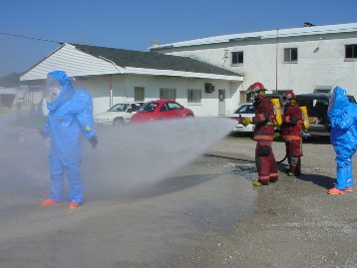
Exercise Categories: Operations-Based
Operations-based exercises validate plans, policies, agreements and procedures, clarify roles and responsibilities, and identify resource gaps in a field environment.
Notes:
Operations-based exercises focus on action-oriented activities such as deployment of resources and personnel
Logistically complex and can be costly
Involve deployment of resources and personnel
Provide a mechanism for validating plans, policies, agreements, and procedures
Help to clarify roles and responsibilities
Improve individual and team performance
Include drills, and both functional and full scale exercises
Are beyond the scope of this training!

Slide 11
How to Use the Tabletop Exercise Tool
Notes:
The TTX Tool is easy to use and consistent with HSEEP
Designed for both novice and experienced TTX planners
(Additional resources would be needed for more complex, operations-based exercises)
Allows planners to develop and design a TTX specific to their organization
Ensures that materials are consistent with HSEEP methodology
Allows organizations to align their exercises with what is becoming the nationally accepted standard for exercise terminology and methodology

Slide 12
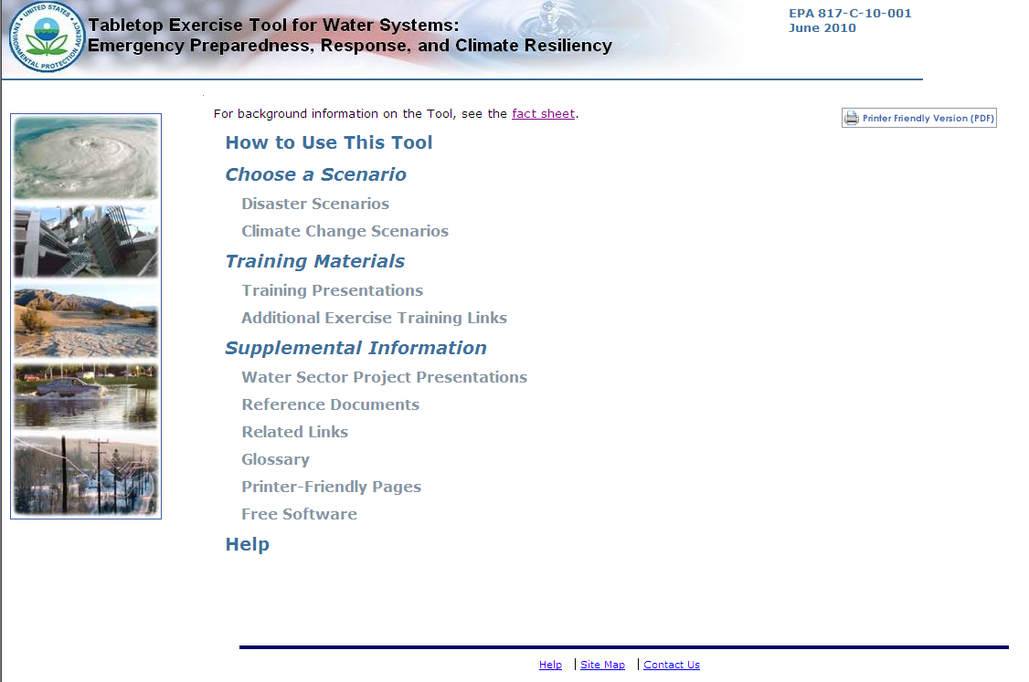
Tabletop Exercise Tool for Water Systems:
Functionality
Instructions on how to get started
Choose from 15 different exercise scenarios.
Each with a customizable:
-Situation Manual
-Presentation
-Additional Discussion Questions
Presentations on how to :
-Use the TTX Tool
-Plan, customize, conduct,
and evaluate an exercise
Water Sector-related presentations,
documents, and web links aid the
exercise planner in building a more
comprehensive TTX
-Links to training presentations and reference materials
-Contact E-mail address
Notes:
Now I would like to walk through some of the functionality of the TTX Tool. This is the home page of the TTX Tool. This page would automatically load in your internet browser after inserting the TTX Tool into your CD drive.
The “How to Use This Tool” provides general background information on the TTX tool as well as instructions on how to get starting using the materials in the tool. The “Choose a Scenario” page allows you to choose from the 15 different scenarios. Each scenario is equipped with a customizable Situation Manual, PowerPoint presentation, and additional discussion questions.
The “Training Presentations” page links you to a number of training PowerPoint presentations on how to use the TTX Tool as well as how to plan, customize, conduct, and evaluate a TTX. These presentations are included so that any user can quickly and easily get acclimated to using the tool. The tool is designed so that anyone will be able to use the tool, whether you’ve been planning exercises for years, or you’ve never even heard of a tabletop exercise—we’ve got you covered. The tool also includes links to online Independent Study FEMA courses on exercising.
The “Supplemental Information” page contains useful documents, links, and PowerPoint presentations on other Water Sector Initiatives such as WARNs (which Steve presented on earlier), ICS and NIMS training, and the Water Laboratory Alliance. The user can draw from all of these materials in order to build a more comprehensive TTX.
Note that in the corner of this page is a button that says “Printer Friendly Version.” Clicking on this button will automatically open a printable PDF version of the page you are currently viewing. You will find one of these buttons on every page of the TTX Tool. You can access the printer-friendly versions of all pages by clicking on the “Printer Friendly Pages” link here on the main page or on the sidebar of any other page. Let’s go to that page now.

Slide 13
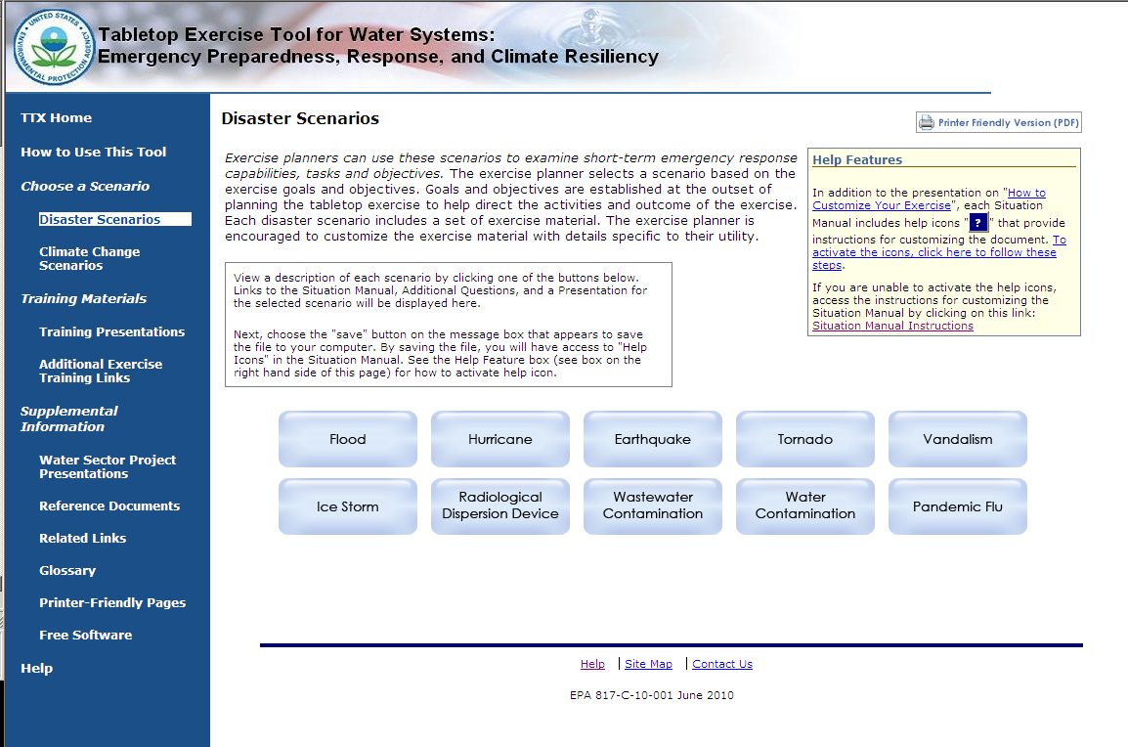
Tabletop Exercise Tool for Water Systems:
Choosing a Scenario
Notes:
The first step in planning a TTX is to select a scenario. Here we are on the “Disaster Scenario” page. We’ve included a 10 different disaster scenarios so the user can select a scenario that is relevant to their region, and objectives for the exercise.
Now we’re going to select a scenario to take a closer look at some of the materials included in the tool for each scenario.

Slide 14
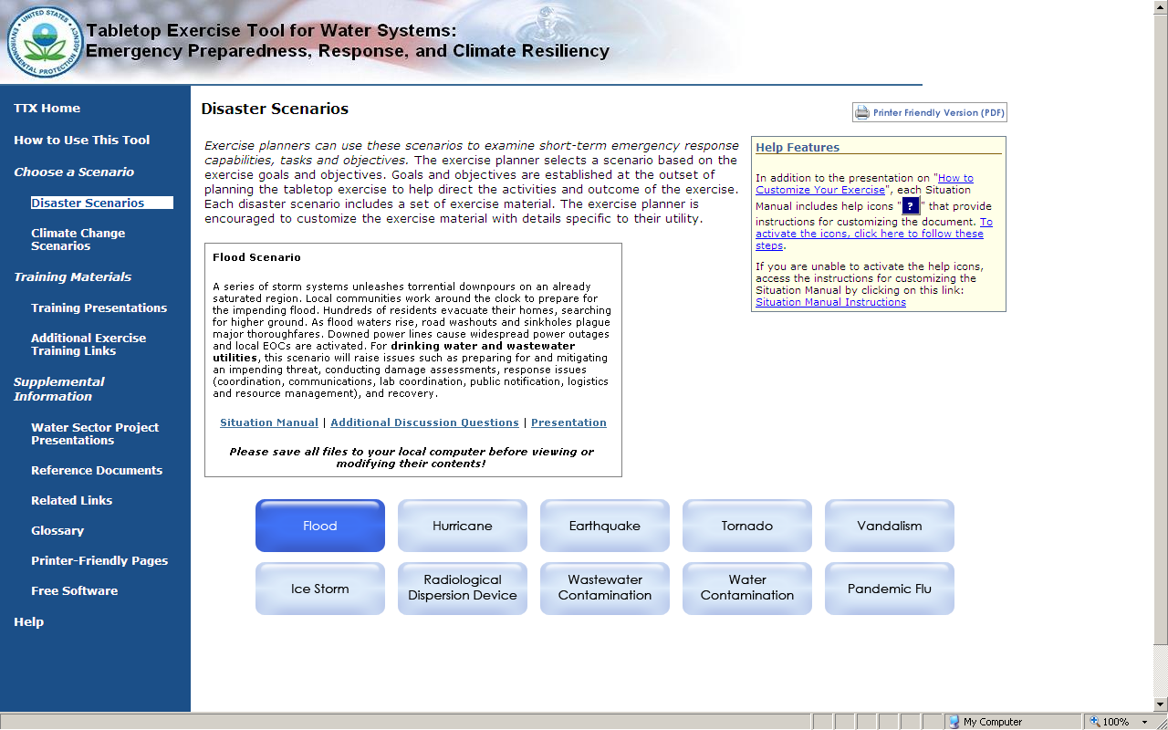
Tabletop Exercise Tool for Water Systems: Customizable Materials
- Macros guide users through design process
- Scenario Description
- Discussion Questions & Key Issues
- Action Planning Session Materials
- Reference Materials
Specific to both drinking water and
wastewater utilities
- Divided into eight categories
- Accompanies SitMan
Users can add images and other
relevant information
Notes:
You can see that after selecting a scenario (here, we’ve selected “Flood”), you can see that a brief description of the scenario shows up in this box. In the box are also links to the customizable SitMan, Additional Discussion Questions, and PowerPoint presentation. Here you can see some of the different features of each of the materials.
For example, pulling from the additional discussion questions helps the exercise planner guide the discussion in any way they choose, in order to meet their exercise objectives.
The PowerPoint presentation serves to accompany the SitMan during the exercise. Users can customize this presentation by adding utility-specific information, as well images and other details.
All of these materials were developed to be very inclusive, they essentially have all of the information a utility would need to conduct an exercise. This way, a utility would not need to generate new information, they would simply need to take out whatever was not relevant to their exercise.
6/2/2011
14

Slide 15
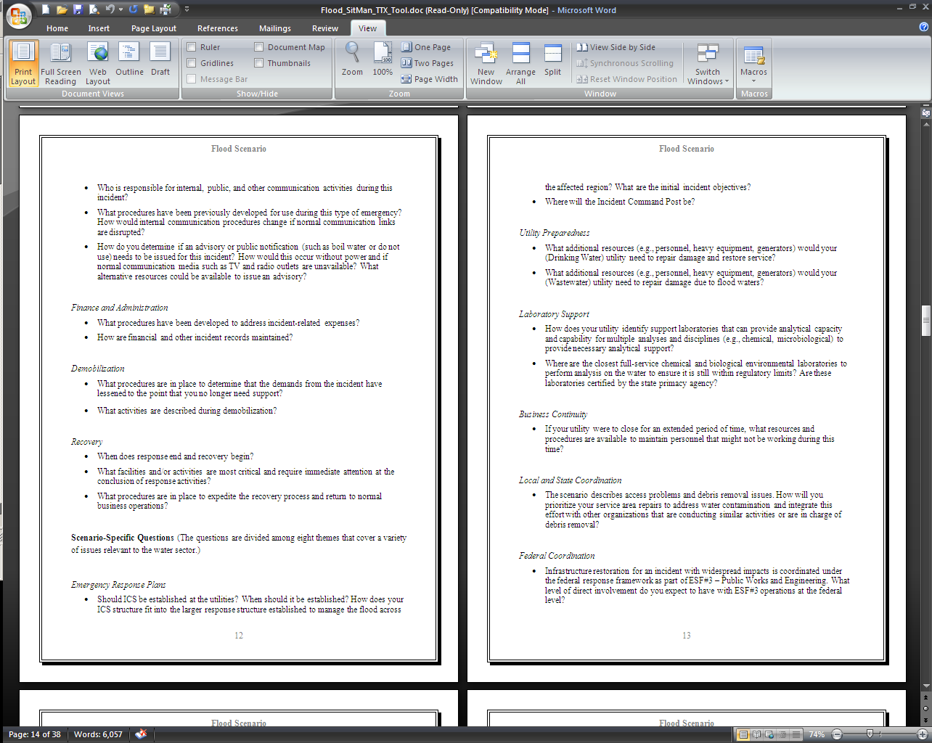
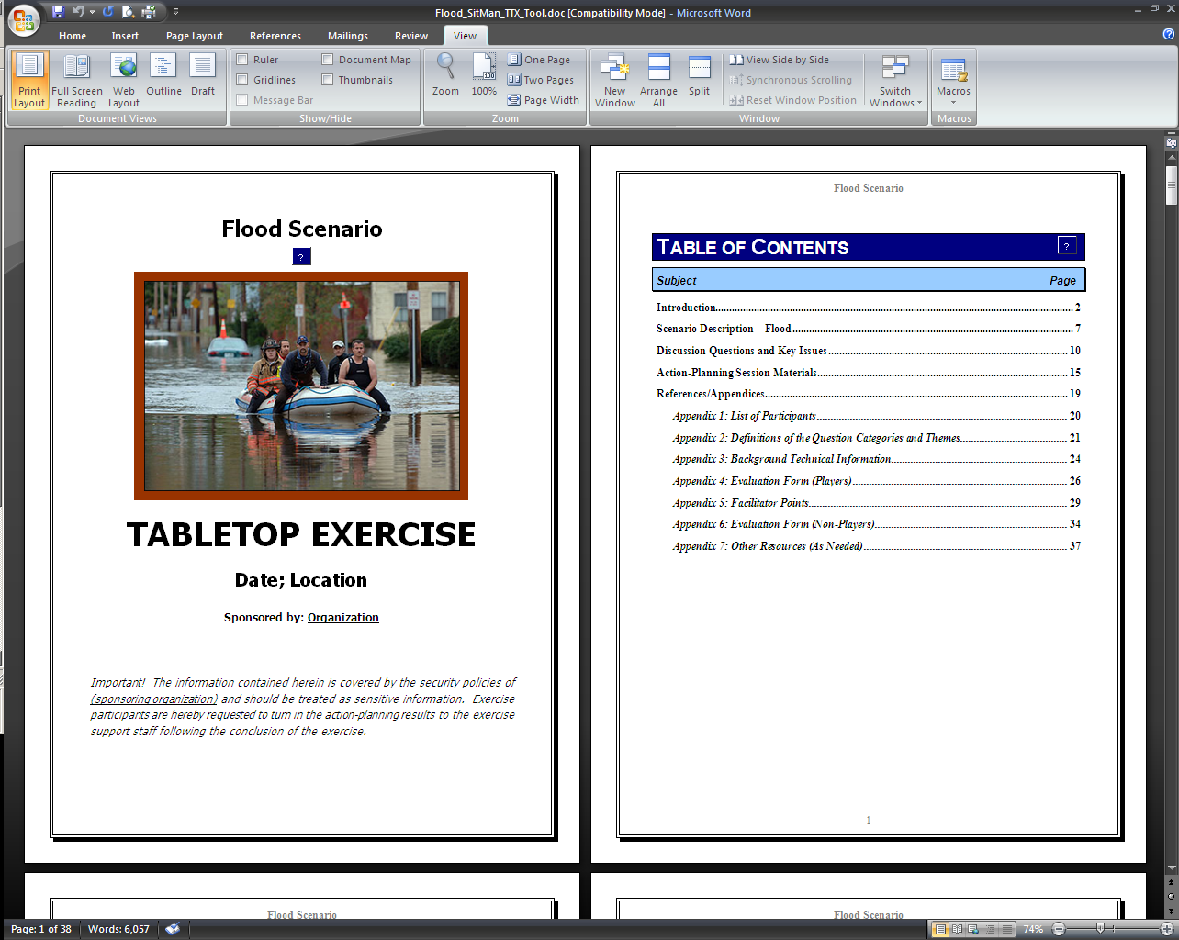
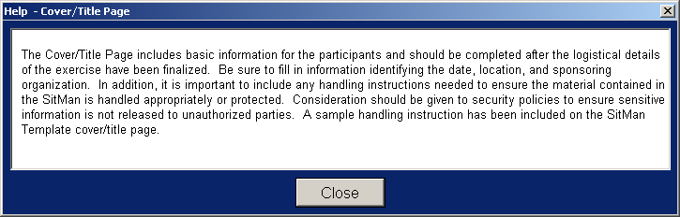
Tabletop Exercise Tool for Water Systems:
Customizable Situation Manual
15
Notes:
Taking a look at the Table of Content, there is a lot of different information, everything the facilitator would need to conduct and evaluate a tabletop exercise. There’s a scenario description, discussion questions and key issues, action planning materials, and a number of reference information.
If you’ll take a look here at this question mark box—these are Macros, and they are inserted throughout the SitMans. Clicking on them will open up a dialogue box that contains instructions on how best to customize that section of the SitMan. This particular macro provides information on the customizing the Cover Page.
Going to the discussion questions, you can see there are a number of different categories to choose from, allowing you to tailor your exercise to meet your needs. For example, there are questions on “Laboratory Support,” so you would be able to exercise your laboratory capabilities.

Slide 16
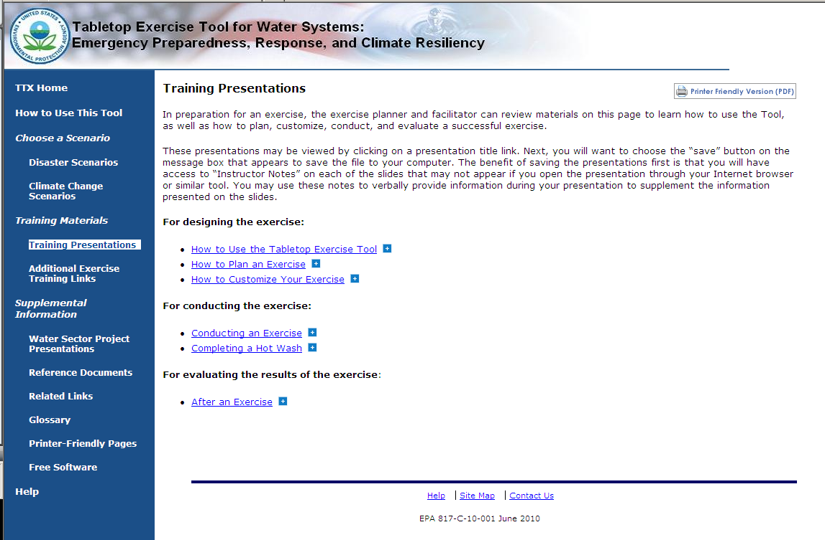
Tabletop Exercise Tool for Water Systems:
Training Presentations and Resources
Text
Notes:
In addition to the “How to Use This Tool” presentation, there are a number of other training resources available on the TTX Tool. Going to the Training Presentations page, you can see that there are PowerPoint presentations on how to plan, customize, conduct, and evaluate your tabletop exercise. These presentations really help to guide users through the entire process of building an effective exercise.

Slide 17
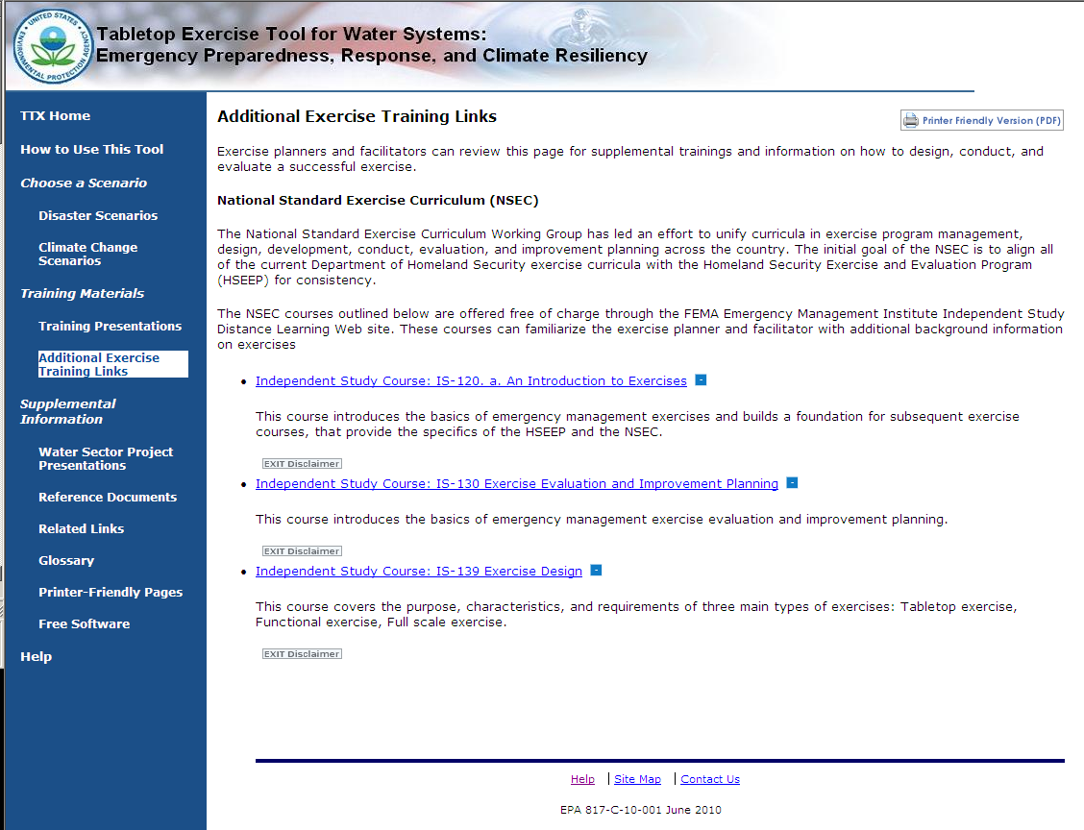
Tabletop Exercise Tool for Water Systems:
Training Presentations and Resources
Text
Notes:
We have also included a number of links to FEMA Independent Study courses on exercising. Clicking on these links will direct the user to FEMA’s website where they will be able to take the course, and get credit for its completion. Again, all of the resources included in the tool really aim to help the user become a seasoned tabletop exercise planner and facilitator.

Slide 18
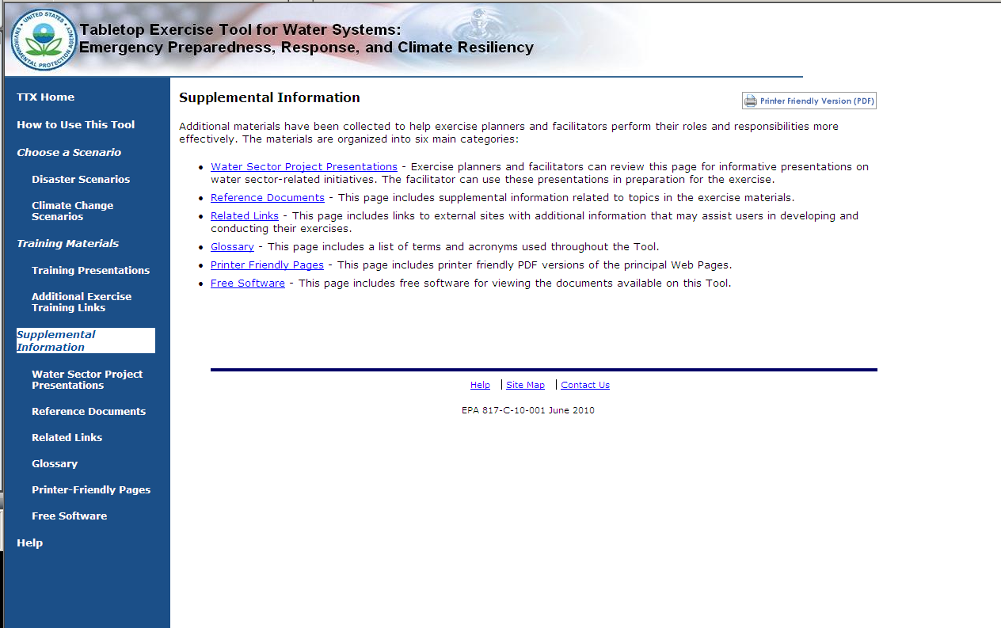
Tabletop Exercise Tool for Water Systems:
Supplemental Information
Notes:
The pages under the “Supplemental Information” heading provide additional resources that contain information on other Water Sector initiatives, documents, and webpages that can be used by the exercise designer/facilitator to build a more comprehensive TTX. We’re going to give a brief overview of those pages now.
Clicking on the Water Sector Project Presentations link, will bring you to this page.

Slide 19
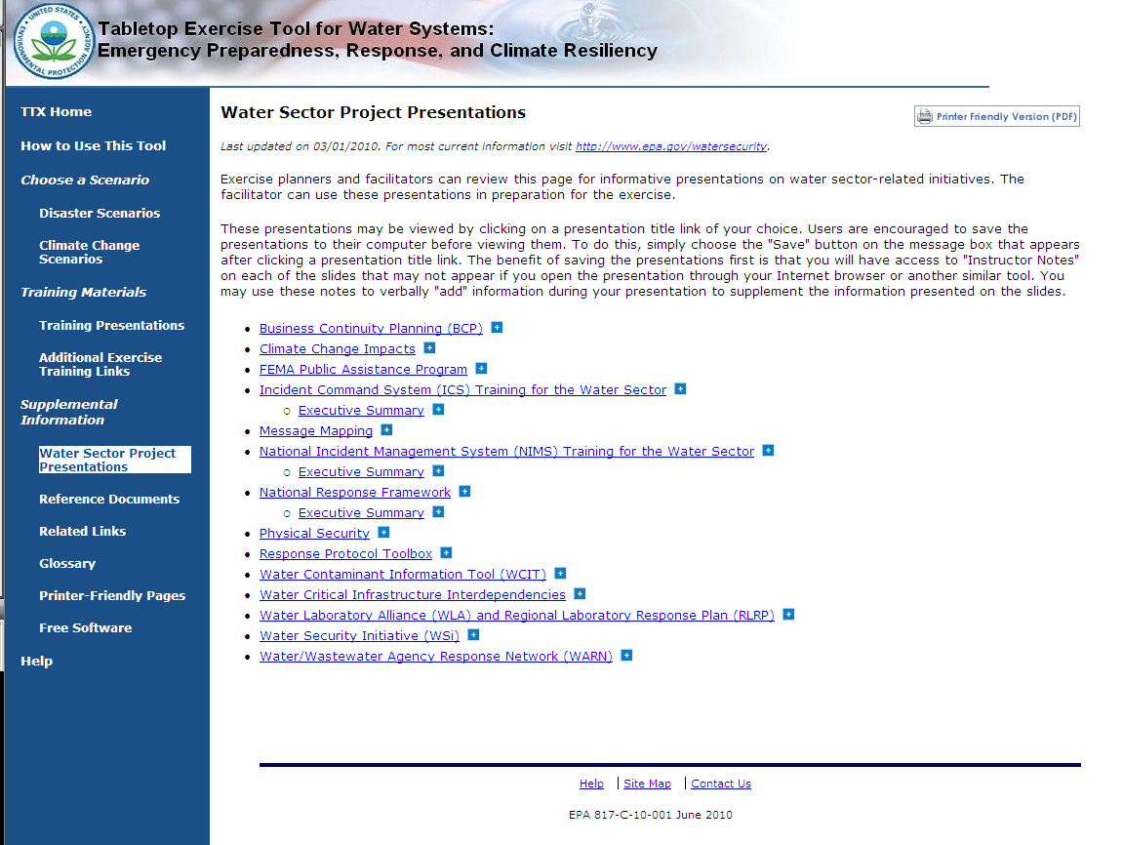
Tabletop Exercise Tool for Water Systems:
Water Sector Project Presentations
Text
Notes:
Here you can see that powerpoint presentations on current EPA Water Sector Initiatives are listed. Users can view these presentations to learn more about a particular topic, to give a presentation to exercise participants at some point during the exercise, or to reference the benefits of a program during the exercise itself.
For example, if the exercise facilitator wanted the participants to discuss Mutual Aid and Assistance during the exercise, they could open the WARN presentation and find out more information, and how to incorporate it in their discussions.

Slide 20
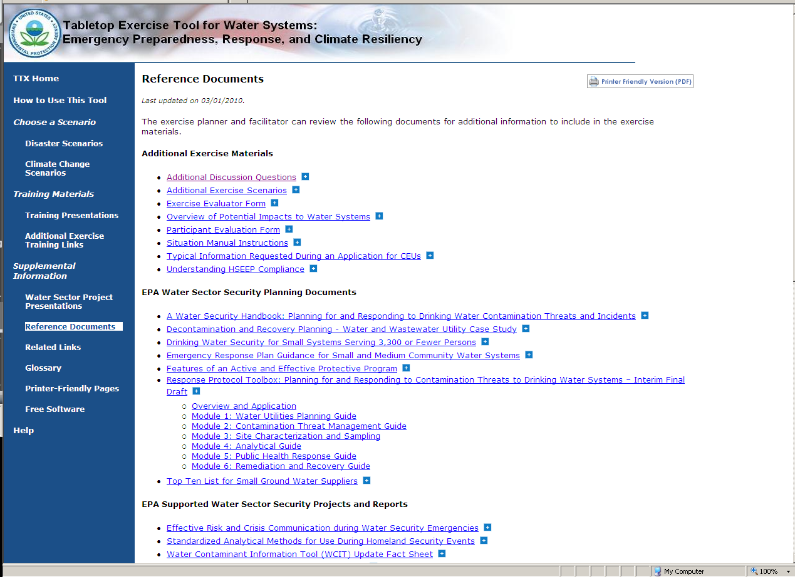
Tabletop Exercise Tool for Water Systems:
Reference Documents
Notes:
The Reference Documents Page lists a number useful published documents that provides a great deal of background information on the Water Sector. There are a number of categories of documents on this page:
Additional Exercise Materials lists Microsoft Word versions of documents related to or included in the tool. Clicking on “Situation Manual Instructions” opens up the Word version of the instructions included in the Situation Manual macros.
EPA Water Sector Security Planning Documents includes a number of Water Security Division-published documents, including the Water Security Handbook.
Other categories include:
EPA Supported Water Sector Security Projects and Reports;
Water Sector Mutual Aid and Assistance Documents;
Climate Change information related to the Water Sector; and
National Level Planning Documents (such as applicable HSPDs, the Water SSP, and the National Response Framework)

Slide 21
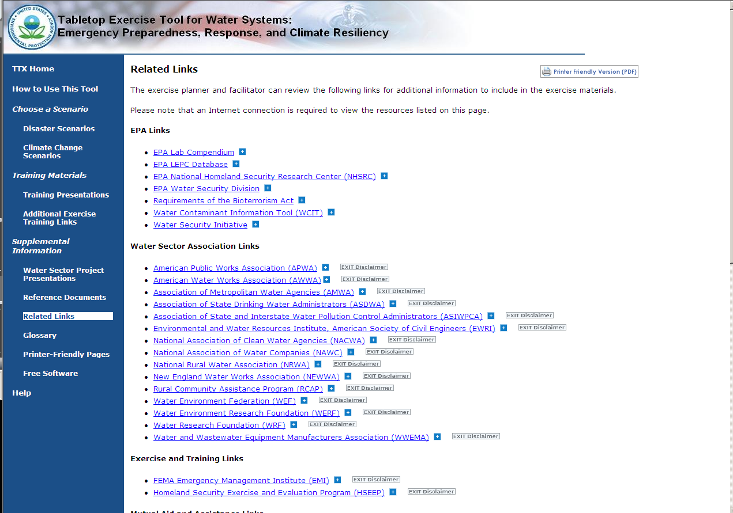
Tabletop Exercise Tool for Water Systems:
Related Links
Notes:
The related links page lists EPA links, such as the Water Security Division’s webpage; Water Sector Associations, such as ASDWA; also links to training and exercise resources, mutual aid and assistance, climate change, and links to other federal agencies.

Slide 22
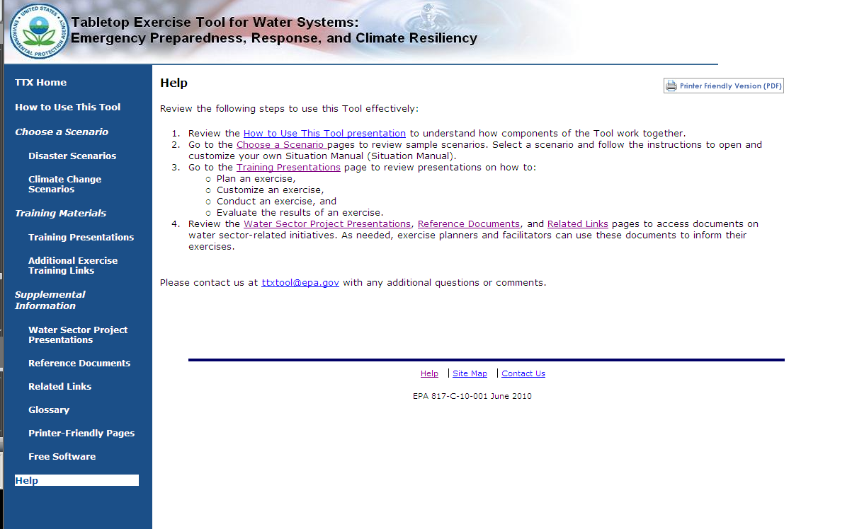
Tabletop Exercise Tool for Water Systems:
Help Page
Notes:
The Help page provides links to presentations and pages within the tool to help users get started. It also includes a link to an email address users can write to if they have any questions or feedback. There is a link to the Help page (as well as a Site Map and a Contact Us page) at the bottom of each page in the tool.

Slide 23
Planning and Designing a Tabletop Exercise

Slide 24
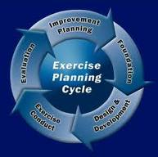
Plan the Exercise
The entire exercise process can be outlined in 5 phases:
Establish the foundation
Design and development
Conduct
Evaluation
Improvement planning
Notes:
Successfully conducting an exercise involves considerable coordination among participating agencies and officials.
The HSEEP methodology divides individual exercises into five overarching phases:
Foundation,
Design and development,
Conduct,
Evaluation, and
Improvement planning.

Slide 25

Establish the Foundation
Develop an exercise planning timeline with milestones
Select participants for an Exercise Planning Team
Schedule planning meetings
Notes:
The exercise planning group should meet to determine the objectives and goals of the exercise.
The exercise planning group can consist of facilitators and evaluators (if they are used), but should not include players.

Slide 26

Design and Development
Identify objectives
Design the scenario
Create documentation
Coordinate logistics
Plan the exercise facilitation
Set focus of evaluation and improvement planning
Notes:
Think of design as the framework of an exercise, and development as the building of that exercise.
Exercise design includes:
Assessing exercise needs
Defining the scope of the exercise
Writing a statement of purpose
Defining exercise objectives
Creating a scenario for the exercise
Exercise development includes:
Creating exercise documentation
Arranging logistics, actors, and safety
Coordinating participants and media
Other supporting planning tasks (e.g., training controllers, evaluators, and exercise staff)
Needs Assessment
The best way to determine the appropriate exercise design is to assess your organization’s or jurisdiction’s capability needs.
A comprehensive exercise program will already have evaluated its organization’s capabilities. Referring to and updating that assessment is an important step whenever a new exercise is considered for development.
The needs assessment will identify:
Functions most requiring rehearsal
Potential exercise participants
Existing exercise requirements and capabilities
Plausible hazards and the priority levels of those hazards
For example, if your jurisdiction has recently updated their Emergency Operations Plan, that plan should then be validated. Therefore, your needs assessment should reflect the desire to design and conduct an exercise which would then test that plan.
Scope
Like "exercises", the word scope has multiple interpretations. Most often, scope defines the kind, rather than number, of exercise participants (i.e., drinking water or wastewater utilities, levels of government, private sector, etc.).
Other interpretations include:
Geographic size (local, national, regional)
Number of participants
Responder functions
Hazard Type
Exercise planners must be careful to make their scope manageable (neither too large nor too complex), selecting only those participants or actions best suited for the exercise program, type, budget, and objectives.
Most exercises focus on one of the following mission areas:
Prevention
Protection
Response
Recovery
Do not try to cover too much when designing an exercise. Try to focus on just one mission area such as response, or recovery. If an exercise tries to cover all four mission areas participants will become overloaded.

Slide 27
How to Pick a Scenario
Depends upon your objectives
Three basic scenario types:
  No-notice incidents (e.g., earthquake)
  Limited notice incidents (e.g., a flood, tornado)
  Gradual incidents (e.g., climate change, pandemic)
No-notice incidents test internal policies and procedures
Limited notice incidents test existing plans and procedures and interactions with other agencies
Gradual incidents test long-term planning and preparedness measures and COOP

Slide 28
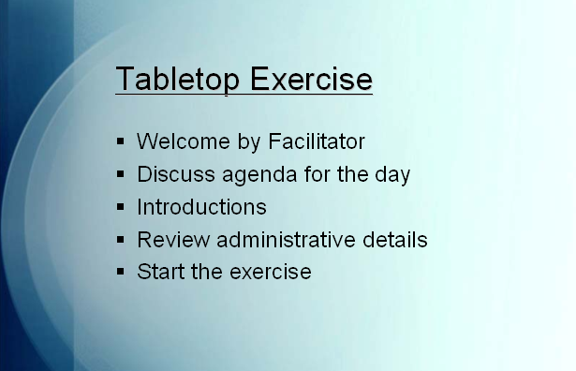
A Scenario Presentation Can Add to the Realistic Feel of the TTX
In addition to the SitMan and the Additional Discussion Questions, the Tool offers a sample presentation that you can use in the facilitation of your exercise
Should be modified to be consistent with your Scenario Description
Include photos of the scenario or the actual physical system
(treatment plants, etc)
where possible
Notes:
The third document available for your exercise is the Exercise Presentation template. If you chose to, you can modify this template with the SitMan/exercise material you have developed and use it as an overhead or handout presentation during the facilitation of the exercise.
The presentation template will need to be modified with material from your SitMan, therefore finalize the presentation last.

Slide 29
Customizing a Tabletop Exercise

Slide 30
SitMan Customization
Notes:
After Action Report / Improvement Plan
An AAR/IP is used to provide feedback to participating entities on their performance during the exercise. The AAR/IP summarizes exercise events and analyzes performance of the tasks identified as important during the planning process. It also evaluates achievement of the selected exercise objectives and demonstration of the overall capabilities being validated.
The IP portion of the AAR/IP includes corrective actions for improvement, along with timelines for their implementation and assignment to responsible parties. To prepare the AAR/IP, Exercise Evaluators analyze data collected from the hot wash, debrief, evaluation forms (players and non-players), and other sources (e.g., plans, procedures) and compare actual results with the intended outcome. The level of detail in an AAR/IP is based on the exercise type and scope.
AAR/IP conclusions may be discussed and validated at an After Action meeting that occurs within a few days or several weeks after the exercise is conducted.

Slide 31
Conducting a Tabletop Exercise

Slide 32
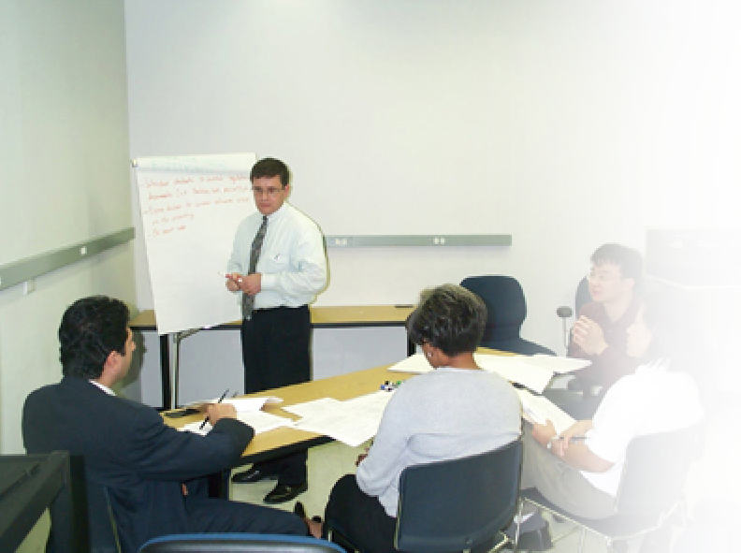
Overview
Conduct entails:
Set-up
Facilitation
Wrap-up
Notes:
Exercise conduct entails the following activities:
Set-up: Preparation of facilities and venues for exercise conduct.
Facilitation: Facilitated discussion is at the core of discussion-based exercises.
Wrap-up: Wrap-up activities are used to gather feedback and discuss evaluation and improvements.
Also, the Facilitator or Exercise Planning Team Leader may choose to provide a presentation prior to the exercise.

Slide 33
1. Set-up
Visit the exercise site the day before the exercise to finalize logistics.
Set-up includes:
  Facility/room
  Registration table with
  sign-in sheets, name
  tags, and pens
  SitMans
  A/V requirements
  Food & refreshments
Name Organization Address Phone
Mary Johnson
Notes:
Exercise set-up should be planned well in advance. If planned properly, setup should not be too difficult. Logistics are often overlooked, but they make the difference between a smooth-running and a confusing exercise.
It is a best practice to visit the exercise site the day before the exercise to ensure all logistics have been finalized and eliminate any last-minute conflicts or problems. Paying attention to small details during exercise set-up ensures the remainder of the exercise, including presentations, facilitation, and wrap-up, go smoothly.
Set-up includes:
Facility/Room
Registration table with sign-in sheets, nametags, and writing utensils
SitMans (situational manuals used by the participants)
Audio/Visual (A/V) requirements
Food and refreshments

Slide 34
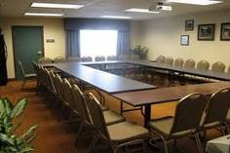
Room Set-up
  Plenary format: players seated together at large conference table
  Another table may be needed for evaluators and observers
Notes:
Depending on the exercise chosen, the number of participants may vary. The exercises contained on the Tool can be run for 5 to 20 Players. Planners must select an exercise room with a large conference table that can accommodate the chosen number of participants comfortably.
If presentations are to be shown, the room should also be equipped with a projection screen, an LCD projector, and a computer. An overhead projector can be used in place of the computer and LCD projector.

Slide 35
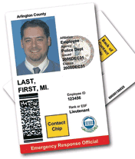
Set-up Tips
Select a secure, private training room
Remind participants to bring ID if required by the host facility
Have additional copies of exercise materials on hand
Take a moment to let
participants introduce
themselves to each other
Notes:
It may be helpful to provide participants with a logistical information sheet prior to the exercise, either sent to them by mail or email. The sheet could include your contact information, the address and directions to the facility, and any other logistical information involved with the exercise. Logistical information may include a map to the area, a map indicating the entrance to the appropriate building, parking requirements, and other pertinent information. Many times the training facility requires photo ID for entrance. If so, a reminder for participants to carry a valid ID should be included in the logistical information sheet.

Slide 36
2. Facilitation
Facilitator Characteristics:
  Should be comfortable talking in front of large groups of people
  Knowledgeable of plans and policies
Facilitator Training:
  Can occur the day before or day of exercise
  Should address:
    Responsibilities
    Preparation
    Exercise specifics (i.e., objectives, scenario, participant questions, exercise materials)
Notes:
A Facilitator should be comfortable talking in front of large groups of people, and he or she should be comfortable managing and guiding a group. Facilitators typically come from the Exercise Planning Team/support staff; participating agencies, organizations, and/or jurisdictions; and neighboring agencies, organizations, and/or jurisdictions.
Training for Facilitators can occur the day before or the day of the exercise. The training should address the responsibilities, preparation, and exercise specifics such as objectives, scenario, participant questions, and exercise materials.

Slide 37
Facilitation Tips
Allow discussions to evolve naturally
Always remain neutral, objective, and fair
Involve the Players whenever possible
Do not be afraid to interrupt people who are rambling
Honor break, lunch, and quitting times
Know when to be quiet; do not answer too many questions
Notes:
All facilitators have slightly different styles, but these tips should help ensure a smooth, effective facilitation session.
Overall, it is important for facilitators to keep Players on track, ensure all issues are explored as thoroughly as possible, and monitor the time to ensure completion of objectives.

Slide 38

Hot Wash
Purpose is to examine the issues identified during the exercise with participants and facilitator(s)
Capture notes from Hot Wash for the After Action Report (AAR)
Notes:
All facilitators have slightly different styles, but these tips should help ensure a smooth, effective facilitation session.
Overall, it is important for facilitators to keep Players on track, ensure all issues are explored as thoroughly as possible, and monitor the time to ensure completion of objectives.

Slide 39
3. Wrap-Up
Participants fill out feedback forms that should solicit, at a minimum:
  Impressions about logistics
  Improvements to future exercises
  Level of satisfaction
Planners should address comments
from feedback forms in future exercises
Evaluation
Form
Notes:
After all discussion-based exercises, wrap-up activities are the final part of exercise conduct. Wrap-up activities are important to the success of the exercise program because they provide insight into how the exercise program went, what was learned, and what could be improved in the future. Wrap-up activities include filling out feedback forms and conducting a debriefing or hot wash.
Feedback forms, including player and non-player Evaluation Form, are an important way for the Exercise Planning Team to measure the success of the exercise. Players and observers complete feedback forms that should solicit, at a minimum:
Impressions about logistics, including quality of facilitation/presentation, adequacy of room, acoustics, food, etc.;
Improvements to future exercises -- including design elements (such as the scenario), and development elements (such as documentation); and
The overall level of satisfaction.
Planners should address comments from feedback forms in future exercises. Comments to address in future exercises include logistic information and scenario choice.

Slide 40

Debrief
To be conducted immediately following the exercise with Exercise Planning Team members to:
Discuss issues or concerns
Propose improvements to exercise design
Capture notes from the “hot wash” for the AAR
Notes:
The debrief is an opportunity to start a dialogue with the Facilitators and Evaluators to capture detailed feedback. It should be conducted immediately following the exercise with Exercise Planning Team members to: ascertain the level of satisfaction among the Exercise Planning Team members while it is still fresh in their minds; discuss issues and concerns while the group is together to resolve concerns before the evaluation and improvement planning process moves forward; and propose improvements to exercise design. Facilitators should keep the conversation constructive when leading a conversation about improvement actions.
A member of the Exercise Planning Team should capture notes from the debriefing to help draft the AAR.

Slide 41
Plan for After the Exercise
The AAR captures the findings of the exercise and provides feedback to the participants
The Improvement Plan (IP) lists corrective actions including timelines for when they need to be addressed or corrected, and who they have been assigned to
Notes:
After Action Report / Improvement Plan
An AAR/IP is used to provide feedback to participating entities on their performance during the exercise. The AAR/IP summarizes exercise events and analyzes performance of the tasks identified as important during the planning process. It also evaluates achievement of the selected exercise objectives and demonstration of the overall capabilities being validated.
The IP portion of the AAR/IP includes corrective actions for improvement, along with timelines for their implementation and assignment to responsible parties. To prepare the AAR/IP, Exercise Evaluators analyze data collected from the hot wash, debrief, evaluation forms (players and non-players), and other sources (e.g., plans, procedures) and compare actual results with the intended outcome. The level of detail in an AAR/IP is based on the exercise type and scope.
AAR/IP conclusions may be discussed and validated at an After Action meeting that occurs within a few days or several weeks after the exercise is conducted.

Slide 42
TTX Tool Outreach and Training
Download the TTX Tool at http://yosemite.epa.gov/ow/SReg.nsf/description/TTX_Tool
  *Available on the WaterISAC portal, keyword “TTX Tool”
Request physical copies* by emailing ttxtool@epa.gov
Train-the-Trainer Workshops
  Planned for Montana, Tennessee, Florida, Missouri, and Massachusetts
  Register at www.horsleywitten.com/ttxtool
*Physical copies of the tool will not work in a Mac computer
Notes:
Link to download the TTX Tool or to request physical copies.
Placeholder slide for the training in June.

Slide 43
Poll Question
Do you feel comfortable planning and facilitating your own TTX using the materials on the TTX Tool?
Yes
No
Will you use the TTX Tool to help plan a TTX?
Yes
No
Notes:
After Action Report / Improvement Plan
An AAR/IP is used to provide feedback to participating entities on their performance during the exercise. The AAR/IP summarizes exercise events and analyzes performance of the tasks identified as important during the planning process. It also evaluates achievement of the selected exercise objectives and demonstration of the overall capabilities being validated.
The IP portion of the AAR/IP includes corrective actions for improvement, along with timelines for their implementation and assignment to responsible parties. To prepare the AAR/IP, Exercise Evaluators analyze data collected from the hot wash, debrief, evaluation forms (players and non-players), and other sources (e.g., plans, procedures) and compare actual results with the intended outcome. The level of detail in an AAR/IP is based on the exercise type and scope.
AAR/IP conclusions may be discussed and validated at an After Action meeting that occurs within a few days or several weeks after the exercise is conducted.

Slide 44
Contact Information
John Whitler, whitler.john@epa.gov
Amy Posner, posner.amy@epa.gov
Caitlin Stormont, stormont.caitlin@epa.gov
Tom Noble, tnoble@horsleywitten.com
Your feedback and questions: ttxtool@epa.gov
Notes:
Link to download the TTX Tool or to request physical copies.
Placeholder slide for the training in June.

Slide 45
For a limited time, the U.S.
Environmental Protection Agency is offering FREE 12-month subscriptions to WaterISAC Pro.
Benefits of WaterISAC PRO
Who Should Subscribe?
Latest, sensitive information about critical infrastructure protection
Emergency management resources
Alerts about emerging risks
Direct access to contaminant databases
Intelligence analysts who help interpret and evaluate threats
Free webcasts on current water security topics
Utility staff
Information security staff
Public health officials
Relevant local, state and federal personnel
Emergency response staff
Infrastructure protection managers
Water quality personnel
Association staff
Law enforcement and intelligence personnel
Subscribe at www.WaterISAC.org
Upgrade an existing account at www.WaterISAC.org/manage
Email us at info@waterisac.org or analyst@waterisac.org
Notes:
45

Slide 46
U.S EPA’s Tabletop Exercise Tool for Water Systems: Emergency Preparedness, Response, and Climate Resiliency – Training Webinar
Additional Questions / Feedback about the TTX Tool?
    Send emails to ttxtool@epa.gov
Notes:
46

